Slide 2
Unsupervised Representational Learning of Hierarchical Graphs with Graph Convolutional Networks
Master’s Thesis by Frimpong Boadu
Supervised by Dr. Erich Baker

Slide 3
INTRODUCTION
RELATED WORKS
METHODOLOGY
EXPERIMENTS & RESULTS
CONCLUSION & FUTURE WORK
TABLE OF CONTENTS

Slide 4
Definition of Terms
Homology refers to shared similarity due to ancestry between pair of genes. Geneweaver uses homology IDs to translate genes between species.
Ontology is a formal representation of a body of knowledge within a given domain, it usually consist of a set of classes with relations that operate between them. In Geneweaver, the classes are relevant terms from Diseases, Biological Processes, Molecular Functions, Cellular Components, among others.
INTRODUCTION

Slide 5
Problem Statement
Interpreting functional genomic data usually correlates gene and protein expression with phenotype.
Geneweaver provides several analysis tools to infer relationships between genes and phenotypes.
The available tools infer relationships based solely on set memberships. As a result, they only use one class of feature for each analysis run.
These methods based on direct gene inclusion/set memberships of genes with phenotype provide reasonable correlations, however, they fail to capture several biological phenomena which may be spread across multiple features.
We propose an approach that combines the network structure of aggregated features to capture knowledge about genes and their correlation with phenotype.
INTRODUCTION

Slide 6
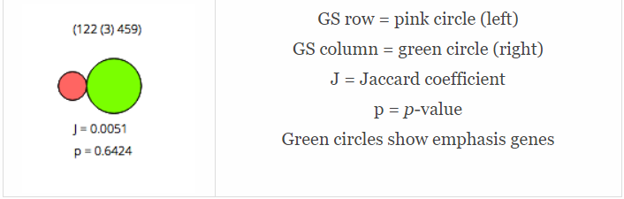
Problem Statement
INTRODUCTION
With the Jaccard similarity tool, a sample is drawn for a class of features.
we can find the similarity/dissimilarity between for that feature class.
The p-value of the score is computed, to determine if the score is significant.
We are limited to only one feature class at any given time.

Slide 7
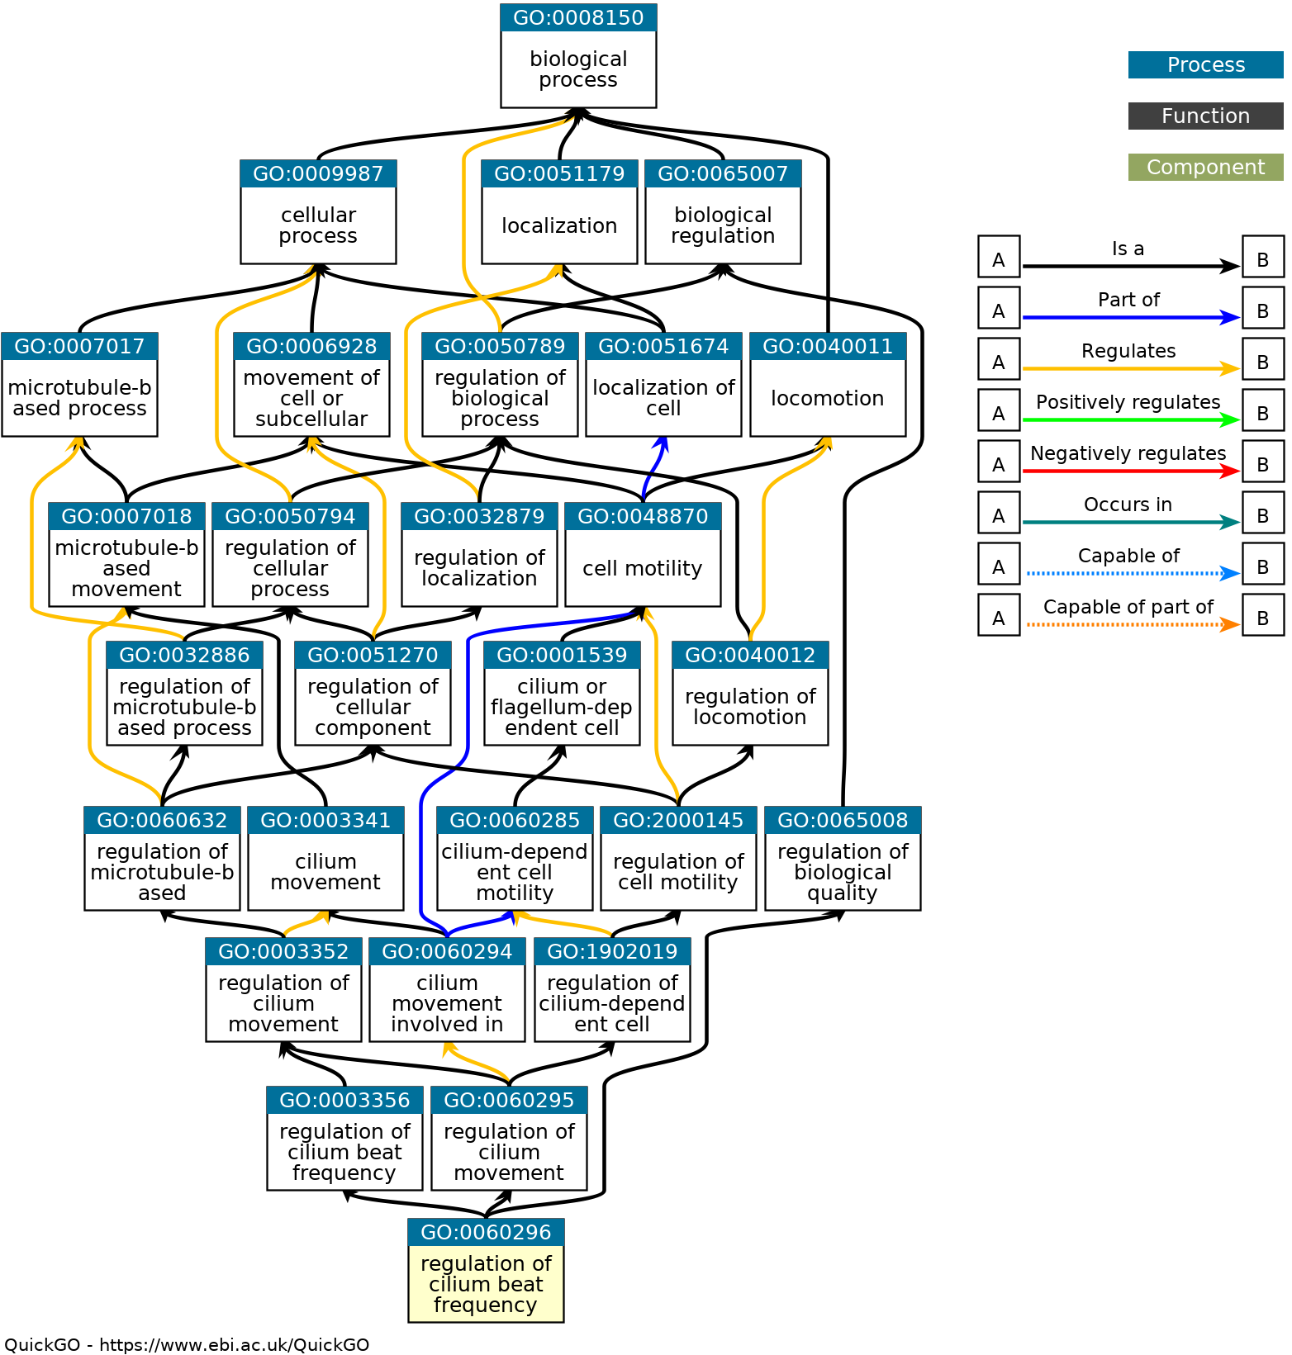
Problem Statement
QUESTIONS
How can we combine and make use of multiple relations for analysis?
Will a combination of multiple relations give different contextual information?
The proposed approach is based on convolution neural networks.
INTRODUCTION

Slide 8
Objectives
Do methods based on convolutional neural networks to identify similar gene sets produce significantly different results from methods based on direct gene inclusion using set memberships?
Does a convolutional neural network mediated tool provide contextual benefit over the set membership tools?
Are the results produced via a convolutional neural network mediated analysis based on an artifact of the data structure, or related to the genesets/phenotype under consideration?
INTRODUCTION

Slide 9
GENEWEAVER
Geneweaver is a repository of genes curated from multiple sources and a suite of several tools available for analyzing and exploring genes and set of genes.
The platform allows users to integrate diverse functional genomics data across species and address questions about the relationship among genes, set of genes and other biological functions.
Application includes the prioritization of gene-disease associations from multiple evidence sources, the classification and comparison of biological functions based on biological substrates, and the identification of similar genes based on functions.
https://geneweaver.org
RELATED WORKS

Slide 10
Survey of Tools
Biclique Enumeration Tool, for enumerating all maximal bicliques of selected Genesets, representing the intersection of shared genes.
Hierarchical Similarity(HiSim) Graph Tool, for generating a combined graph from enumerated maximal bicliques, using the connected components.
Jaccard Similarity Decomposition tool, for finding overlapping GeneSets and evaluating the similarity between genesets using the shared genes.
DBSCAN Gene Clustering Tool.
Modular single-set enrichment tool(MSET) tool, among others.
RELATED WORKS

Slide 11
Graph Representation Learning
Graph representation learning refers to methods that are used to learn embeddings of nodes or entire (sub)graphs, as points in a low-dimensional vector space.
Embeddings are representations of nodes, edges, and their features in vector space(preferably low dimension) whilst preserving graph structure and information.
They have led to massive contributions in domains such as chemical synthesis, social network analysis, biological protein-protein networks, recommender systems, etc.
Examples are Graph Convolutional Networks, Graph Auto-Encoders, GraphSAGE, Variational Graph Auto-Encoders, etc.
RELATED WORKS

Slide 12
Clustering
Clustering is an unsupervised learning that deals with grouping items or a set of data point into groups such that members in the same group are more like each other than those in other groups.
Partition based: example K-means and K-medoids.
Distribution based: example DBCLASD and GMM.
Density based: example Density-based spatial clustering of applications with noise(DBSCAN).
RELATED WORKS

Slide 13
Distance & Similarity Measures
Distance metrics are generally used to measure how far apart two points are in some given space and similarity measures are used to measure how close together two points are in some given space.
Some common distance measurements are the Euclidean distance, cosine similarity, Pearson correlation, Manhattan distance etc.
RELATED WORKS

Slide 14
Gene Set Enrichment Analysis
Gene Set Enrichment Analysis (GSEA) is a computational method that determines whether an a priori defined set of genes, shows statistically significant concordant differences between two biological states.
It is used to identify classes of genes or proteins that are overly represented in a large set of genes or proteins and may have an association with some biological process.
GSEA can help provide molecular evidence for the association of biological pathways with diseases, they can be used to help understand the molecular mechanisms of complex disorders and the discovery of new suspect genes related to some biological process.
RELATED WORKS

Slide 15
Summary of Methodology
Feature Generation with Graph Autoencoder.
Grouping of Similar Gene Sets using K-Means Clustering Algorithm.
Similarity Measurement and Ranking with Euclidean Distance.
Identifying Underlying Biological Processes using GSEA.
METHODOLOGY

Slide 16
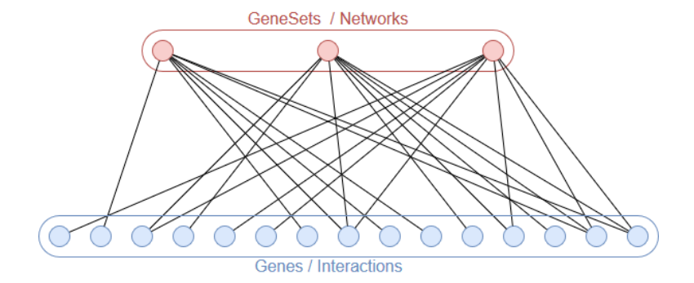
Example Graph Structure
METHODOLOGY
A typical graph usually consist of Phenotypes, Genesets, Networks or sub-networks as nodes.
There is a connection/ edge between nodes if they share some features like genes, ontology, interaction, and several others.

Slide 17
Feature Generation
In the first phase, we generate node embeddings for the given, using a Graph Autoencoder (GAE).
The GAE uses convolutional neural networks based on Auto-Encoders and Variational Auto Encoders.
The full GAE network consist of a Graph Convolutional Network(GCN) as an encoder and an inner product decoder.
METHODOLOGY

Slide 18

Encoder
The encoder is an inference model constructed using layers of GCNs, it maps the input graph into a low dimensional representational Z in latent space.
The equation for the encoder is given as
where Ấ is the symmetrically normalized adjacency matrix, w_{i} is the weight matrices for each layer and i is the layer under consideration.
Each layer, takes input features and the adjacency matrix of the graph and produces output features.
METHODOLOGY

Slide 19
Encoder
The equation for the encoder
The initial features are used as input for the first layer, for the rest, the output of a layer is used as input for the next layer.
the number of layers corresponds to the neighborhood that the node aggregates information from.
Here gene memberships can be used to construct the graph or used as features.
We can also use the relational-GCN, which allows multiple features, as well as allowing priorities to be assigned to each feature.
METHODOLOGY

Slide 20
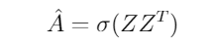
Decoder
The decoder is a generative, used to reconstruct the input graph from the final embedding.
It is defined as an inner product between the embedding, as shown below.
where Ấ reconstructed adjacency matrix and Z is the final embedding. A logistic sigmoid function is applied to Ậ to acquire the appropriate probabilities.
And a suitable threshold is set to specify which probabilities signify an edge between two nodes.
METHODOLOGY

Slide 21
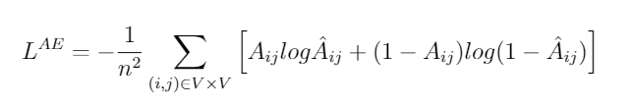
Decoder
The reconstruction loss is formulated as a cross-entropy loss defined as
In cases where our dataset is sparse and imbalanced, we apply a link re-weighting strategy to reinforce the relative importance of positive link/negative links(thus which class is minority).
This is done by replicating the number of edges and their corresponding predictions by some factor k, to augment the data or by sub-sampling the data.
In our case we use the former.
METHODOLOGY
Notes:
For instance, if we set a threshold of 0.5, it means that all values less than 0.5 are set as 0, indicating there is no edge between the nodes, and all values greater than or equal to 0.5 are set as 1, indicating that there is an edge between them.

Slide 22
K-Means Clustering
The Second phase is to group the phenotype/relevant biological processes using the generated features.
In our case, given the final embeddings, we apply K-Means algorithm to assign nodes to clusters.
This is akin to using an approach like PCA for dimensionality reduction and then applying K-Means for clustering on the features generated from the PCA.
However, with the use of the Graph Auto-Encoder, we can consider the structure of the graph as well as other graph properties.
METHODOLOGY

Slide 23
Similarity Ranking
The third phase is used to find similar nodes with respect to a given node.
Here we use a distance similarity measurement technique, to find the top k, closest nodes given the embeddings from the GAE.
In this work, we use the Euclidean distance to measure the similarities between nodes.
METHODOLOGY

Slide 24
Identifying Underlying Biological Processes
Given a cluster or a group of similar nodes(phenotypes), we use find the underlying biological processes using geneset enrichment analysis method.
The enrichment analysis provides the biological process with their corresponding p-values by examining a statistical overrepresentation of those genes within ontological term-to-gene mappings.
We can then select the top n biological processes, depending on which p-value or number is needed.
METHODOLOGY

Slide 25
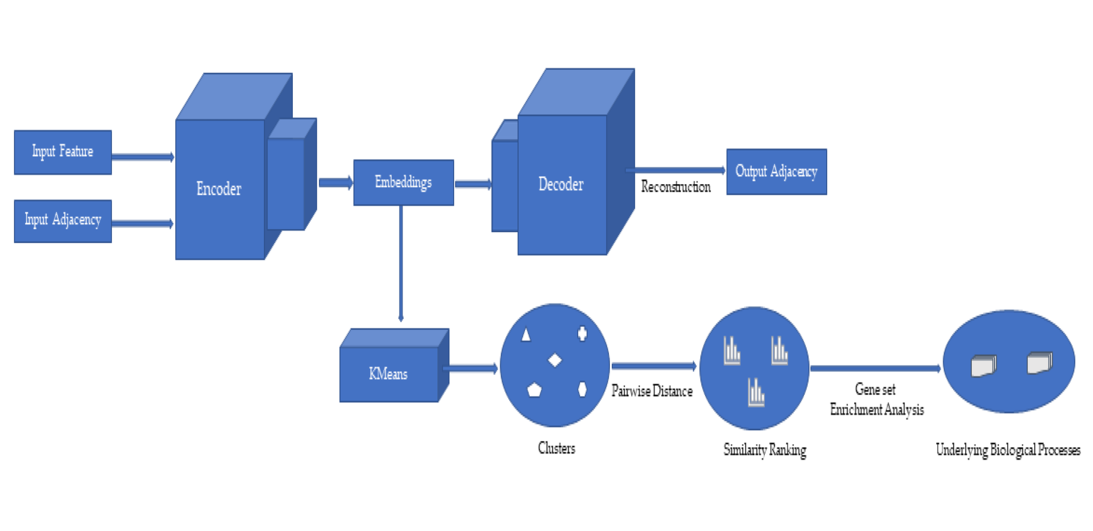
Summary of Approach
METHODOLOGY

Slide 26
AIM OF EXPERIMENTS
To find out if the approach used in this work produces significantly different results from methods based on direct gene inclusion using Jaccard Overlap.
To find if the results produced via our approach are contextually related to gene sets under consideration.
We employ methods in statistics for estimation, combining the similarity measurement and well documented enrichment analysis to determine overrepresented biological processes in samples drawn from the population of gene sets for each adjacency/feature combinations.
EXPERIMENTS & RESULTS

Slide 27
Data Collection & Prepossessing
We used data available in Geneweaver for testing our approach.
For the purpose of this presentation, we focus on all Tier-III Genesets available in Geneweaver. These are genes curated and added to Geneweaver by domain experts.
There is a total of 1241 Gene Sets in this category.
Two different graphs are generated from this data, one based on homology relations(Homology Graph) and the other based on ontology relations(Ontology Graph).
Homology only: Homology as adjacency and feature matrices
Ontology only: Ontology as adjacency and feature matrices
Homology Ontology: Homology as adjacency matrix and Ontology as a feature matrix.
EXPERIMENTS & RESULTS 1

Slide 28
Training, Validation & Testing
The Dataset is split into 3 parts; 70% training set, 20% validation set, and 10% test set.
The table below shows the scores for generating the embeddings and reconstructing the generated embeddings.
VAL : Validation
AP : Average Precision(AP score)
ROC : Receiver operating characteristic(ROC score)
EXPERIMENTS & RESULTS 1
DATASET | ACCURACY | VAL AP | VAL ROC | TEST AP | TEST ROC
Homology-Homology | 0.83 | 0.91 | 0.91 | 0.91 | 0.91
Homology-Ontology | 0.86 | 0.89 | 0.88 | 0.89 | 0.89
Ontology-Ontology | 0.91 | 0.93 | 0.94 | 0.94 | 0.95
Ontology-Homology | 0.90 | 0.92 | 0.92 | 0.92 | 0.93

Slide 29
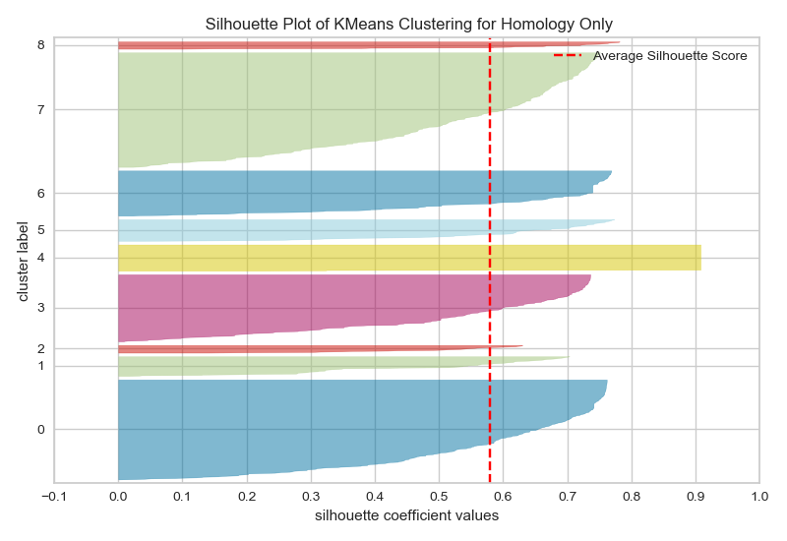
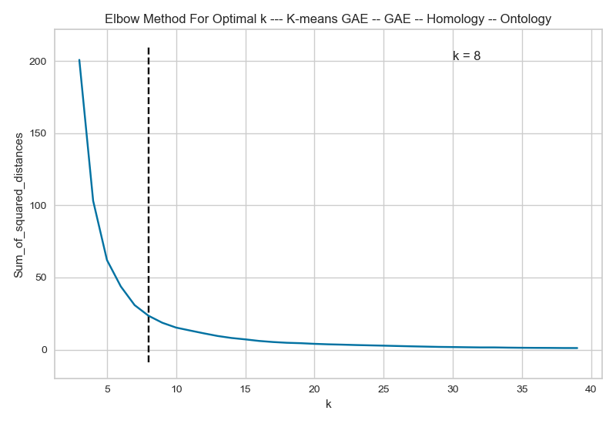
K-Means Clustering
To determine the optimal K, for our K-Means we use the elbow algorithm.
It provides an estimate of the number clusters if appropriate in an analysis.
In this case, k is based on the sum of squared distance (SSE) between data points and the cluster centroids.
We plot the(SSE) against the number of clusters and determine the point where the distortion begins to decrease rapidly between clusters;
that point is determined to be k
Elbow Method For Optimal K
EXTRAS

Slide 30
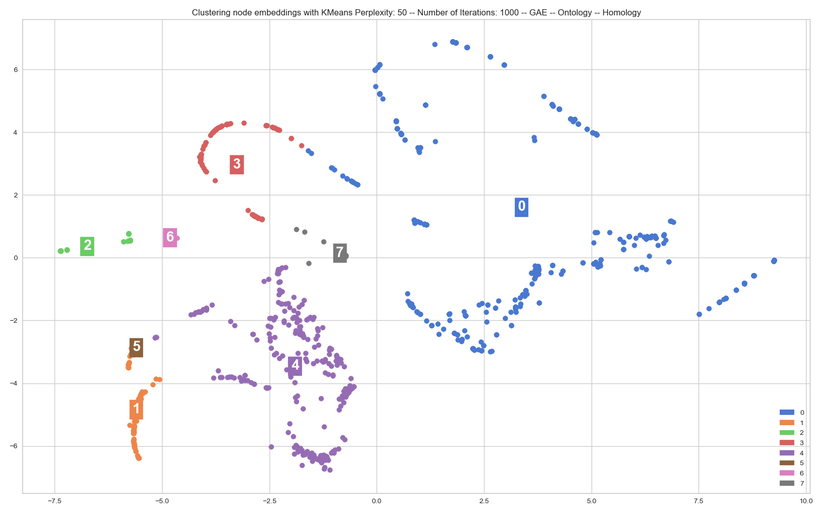
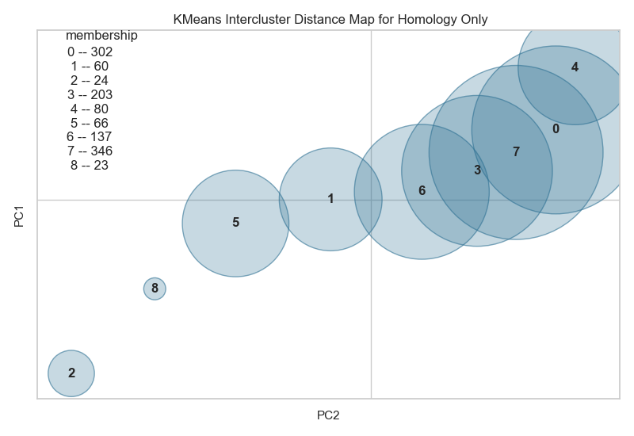
K-Means Clustering
Elbow Method For Optimal K
EXTRAS
To visualize the clusters and their membership, we use TSNE algorithm.
Next, we find the correlation between the underlying biological processes.

Slide 31
Confidence Interval for Correlation
Method | PT. Est | Lower CI | Upper CI
GAE-HOM-HOM vs GAE-HOM-ONTO | 0.749 | 0.696 | 0.803
GAE-HOM-HOM vs GAE-ONTO-ONTO | 0.317 | 0.203 | 0.431
GAE-HOM-HOM vs GAE-ONTO-HOM | 0.452 | 0.393 | 0.511
GAE-HOM-HOM vs JCD-HOM | 0.400 | 0.367 | 0.433
GAE-HOM-HOM vs JCD-ONTO | 0.388 | 0.317 | 0.459
GAE-HOM-ONTO vs GAE-ONTO-ONTO | 0.366 | 0.266 | 0.466
GAE-HOM-ONTO vs GAE-ONTO-HOM | 0.476 | 0.384 | 0.569
GAE-HOM-ONTO vs JCD-HOM | 0.390 | 0.338 | 0.442
GAE-HOM-ONTO vs JCD-ONTO | 0.419 | 0.361 | 0.477
GAE-ONTO-ONTO vs GAE-ONTO-HOM | 0.656 | 0.570 | 0.742
GAE-ONTO-ONTO vs JCD-HOM | 0.430 | 0.378 | 0.482
GAE-ONTO-ONTO vs JCD-ONTO | 0.671 | 0.637 | 0.704
GAE-ONTO-HOM vs JCD-HOM | 0.497 | 0.430 | 0.563
GAE-ONTO-HOM vs JCD-ONTO | 0.632 | 0.593 | 0.670
JCD-HOM vs JCD-ONTO | 0.536 | 0.477 | 0.594
Sample size: 400 genesets
α = 0:05
We find the correlation between the top 5 biological processes(least enrichment p-value) for the selected genesets.
EXPERIMENTS & RESULTS 1
It is interpreted as for each two methods being compared; we are 95% confident that the mean correlation is between the lower CI and the upper CI.

Slide 32
Confidence Interval for Correlation.
At least we can say that the using different graph structure/features produces differing contextual benefits.
However, are the differences resulting from random chance or truly related to the phenotypes?
If the differences are not random, what trends are shown or revealed.
Which one is better/ when is one better than the other.
EXPERIMENTS & RESULTS 1

Slide 33
Data Collection & Prepossessing
Results were compared across three different biologically relevant data sets:
Gene Ontology (GO) Biological Process data set, 2018.
Kyoto Encyclopedia of Genes and Genomes (KEGG) pathway data set, 2019.
Human Phenotype Ontology (HPO) data set.
The GO Biological Process data set uses a directed acyclic graph (DAG) to annotate genes to a carefully curated ontological description of all human biological process and KEGG annotates lists of genes to biological pathways .
The HPO is derived from annotating genes to a phenotype ontology derived from medical literature
In effect KEGG and GO are quite similar in relation to the genes that form the gene sets, while HPO relies on a different foundation from which to derive biological relevance.
EXPERIMENTS & RESULTS 2

Slide 34
Analysis of variance test
(Non-parametric)
For each enrichment analysis, the p-value obtained can be interpreted as a measurement of the confidence that an obtained biological process is due to chance(null hypothesis).
The smaller the p-value, the more likely that the association between the gene set of interest and the obtained biological process is not random.
EXPERIMENTS & RESULTS 2

Slide 35
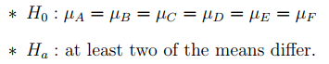
Analysis of variance test
(Non-parametric)
α = 0:05
Hypothesis:
EXPERIMENTS & RESULTS 2
DATABASE | TEST STATISTIC | P-VALUE
GO BIOLOGICAL PROCESS 2018 | 93.0928 | 1.50e-18
HUMAN PHENOTYPE ONTOLOGY | 34.8463 | 1.61e-6
KEGG 2019 HUMAN | 112.7943 | 1.05e-22
Low p-value, which indicates that the results are applicable.
Decisions: Reject all 3 Null hypothesis.
However, the ANOVA TEST is an overall test, so we conduct individual test to find the methods which truly differ.

Slide 36
Dunn’s test.
 | GO BIOLOGICAL PROCESS 2018
 | A | B | C | D | E | F
A | 1.0000 | 1.0000 | 0.0000 | 0.0000 | 0.0000 | 0.0000
B | 1.0000 | 1.0000 | 0.0014 | 0.0006 | 0.0000 | 0.0000
C | 0.0000 | 0.0014 | 1.0000 | 1.0000 | 1.0000 | 0.4572
D | 0.0000 | 0.0006 | 1.0000 | 1.0000 | 1.0000 | 0.7241
E | 0.0000 | 0.0000 | 1.0000 | 1.0000 | 1.0000 | 1.0000
F | 0.0000 | 0.0000 | 0.4572 | 0.7241 | 1.0000 | 1.0000
Homology Adjacency and Homology Features
Homology Adjacency and Ontology Features
Ontology Adjacency and Homology Features
Ontology Adjacency and Ontology Features
Jaccard Homology
Jaccard Ontology
EXPERIMENTS & RESULTS 2
 | KEGG 2019 HUMAN
 | A | B | C | D | E | F
A | 1.0000 | 1.0000 | 0.0000 | 0.0000 | 0.0000 | 0.0000
B | 1.0000 | 1.0000 | 0.0001 | 0.0000 | 0.0000 | 0.0000
C | 0.0000 | 0.0001 | 1.0000 | 1.0000 | 0.1632 | 1.0000
D | 0.0000 | 0.0000 | 1.0000 | 1.0000 | 0.4348 | 1.0000
E | 0.0000 | 0.0000 | 0.1632 | 0.4348 | 1.0000 | 1.0000
F | 0.0000 | 0.0000 | 1.0000 | 1.0000 | 1.0000 | 1.0000
 | HUMAN PHENOTYPE ONTOLOGY
 | A | B | C | D | E | F
A | 1.0000 | 1.0000 | 1.0000 | 1.0000 | 0.0016 | 0.0161
B | 1.0000 | 1.0000 | 0.4004 | 0.5175 | 0.0000 | 0.0003
C | 1.0000 | 0.4004 | 1.0000 | 1.0000 | 0.1193 | 0.6156
D | 1.0000 | 0.5175 | 1.0000 | 1.0000 | 0.0878 | 0.4794
E | 0.0016 | 0.0000 | 0.1193 | 0.0878 | 1.0000 | 1.0000
F | 0.0161 | 0.0003 | 0.6156 | 0.4794 | 1.0000 | 1.0000

Slide 37
Dunn’s test.
 | GO BIOLOGICAL PROCESS 2018
 | A | B | C | D | E | F
A | 1.0000 | 1.0000 | 0.0000 | 0.0000 | 0.0000 | 0.0000
B | 1.0000 | 1.0000 | 0.0014 | 0.0006 | 0.0000 | 0.0000
C | 0.0000 | 0.0014 | 1.0000 | 1.0000 | 1.0000 | 0.4572
D | 0.0000 | 0.0006 | 1.0000 | 1.0000 | 1.0000 | 0.7241
E | 0.0000 | 0.0000 | 1.0000 | 1.0000 | 1.0000 | 1.0000
F | 0.0000 | 0.0000 | 0.4572 | 0.7241 | 1.0000 | 1.0000
So far, we get similar results for the KEGG and GO databases
Using the enrichment database, KEGG 2019 Human, and GO Biological Process 2018, the evidence suggests that at a 5% significance level, the groups B&C are not statistically different from each other but are statistically different from the other groups.
Using the enrichment database, Human Phenotype Ontology, the evidence suggests that at a 5% significance level, B&C are statistically different from F&G, whereas there is not enough evidence to conclude that D&E statistically differs from any of the groups.
EXPERIMENTS & RESULTS 2
 | KEGG 2019 HUMAN
 | A | B | C | D | E | F
A | 1.0000 | 1.0000 | 0.0000 | 0.0000 | 0.0000 | 0.0000
B | 1.0000 | 1.0000 | 0.0001 | 0.0000 | 0.0000 | 0.0000
C | 0.0000 | 0.0001 | 1.0000 | 1.0000 | 0.1632 | 1.0000
D | 0.0000 | 0.0000 | 1.0000 | 1.0000 | 0.4348 | 1.0000
E | 0.0000 | 0.0000 | 0.1632 | 0.4348 | 1.0000 | 1.0000
F | 0.0000 | 0.0000 | 1.0000 | 1.0000 | 1.0000 | 1.0000
 | HUMAN PHENOTYPE ONTOLOGY
 | A | B | C | D | E | F
A | 1.0000 | 1.0000 | 1.0000 | 1.0000 | 0.0016 | 0.0161
B | 1.0000 | 1.0000 | 0.4004 | 0.5175 | 0.0000 | 0.0003
C | 1.0000 | 0.4004 | 1.0000 | 1.0000 | 0.1193 | 0.6156
D | 1.0000 | 0.5175 | 1.0000 | 1.0000 | 0.0878 | 0.4794
E | 0.0016 | 0.0000 | 0.1193 | 0.0878 | 1.0000 | 1.0000
F | 0.0161 | 0.0003 | 0.6156 | 0.4794 | 1.0000 | 1.0000

Slide 38
Discussion
Thus, we can conclude that overall results produced from using our Ontology dataset as an adjacency matrix is not different from that of the Jaccard in both cases where Homology and Ontology is used as Adjacency matrix.
However, using the Homology as adjacency matrix produces statistical differences between our approach and the Jaccard tool.
When performing GSEA, the p-value of retrieved biological processes provides an indication of the alignment of a set of genes to biological processes. It serves as a surrogate for validating a community output to a cross comparative data set.
The three enrichment libraries used in this analysis (GO, KEGG, HPO) provide excellent p-values for identified processes.
DISCUSSION

Slide 39
What Is Next For Geneweaver
Extend the current Graph Auto-encoder architecture in other to accommodate more features and assign priority/importance to features using Relational Graph Convolutional Networks.
Provide more testing, including human assessment of the clusters, examining the relationship between the overall graph structure and the resulting clusters, etc.
For example, in this work the underlying structure of our ontological relationships is a directed acyclic graph, but we composed and analyzed as an undirected graph.
Regardless, there remains the question that different graph structures need to be accounted for within the analysis pipeline.
FUTURE WORKS

Slide 40
QUESTIONS
SUGGESTIONS
CONTRIBUTIONS
All code available on GitHub
@
https://github.com/frimpz/geneweaver
python pytorch postgresql sklearn
THANK YOU!!!

Slide 41
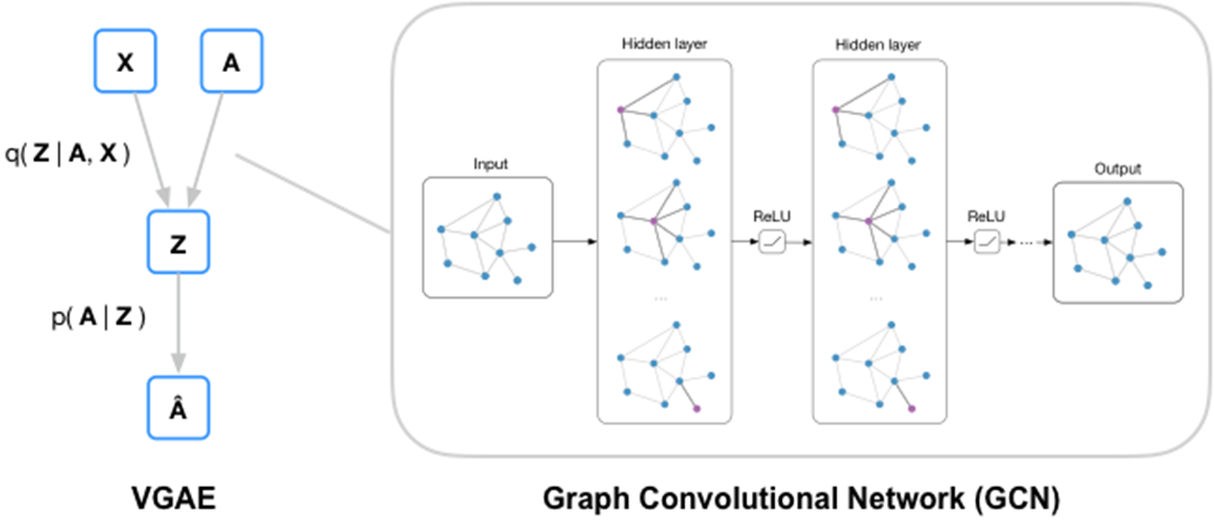
Node Information Aggregation
EXTRAS

Slide 42
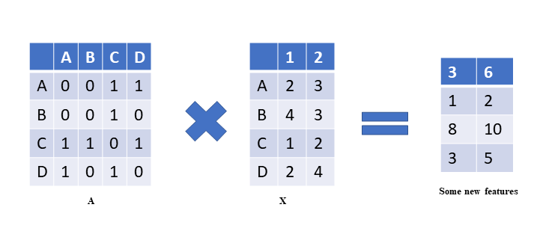
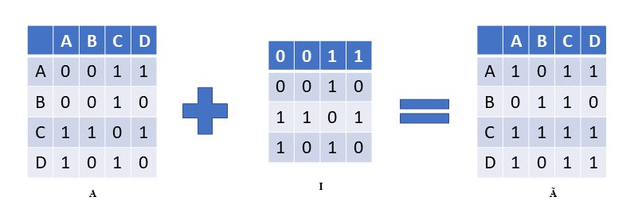
Node Information Aggregation
EXTRAS

Slide 43
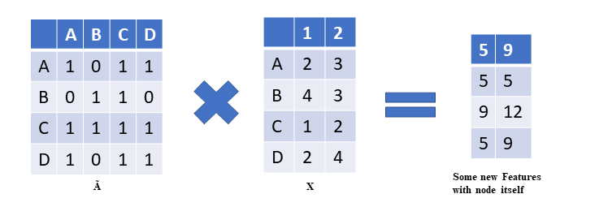
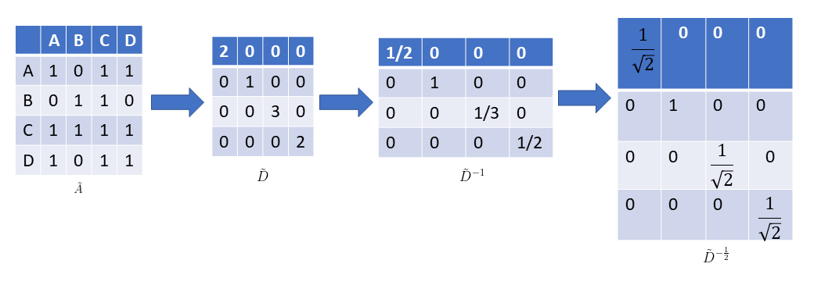
Node Information Aggregation
EXTRAS

Slide 44
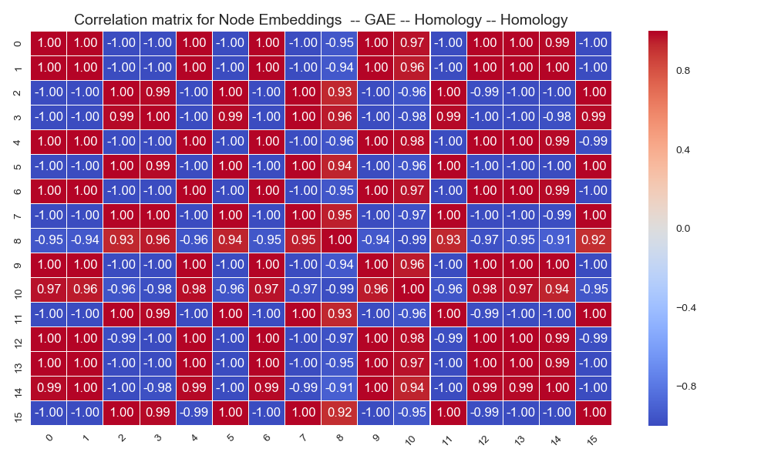
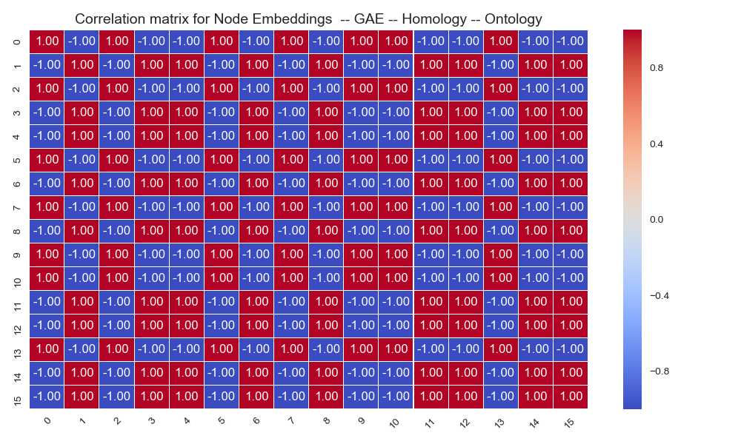
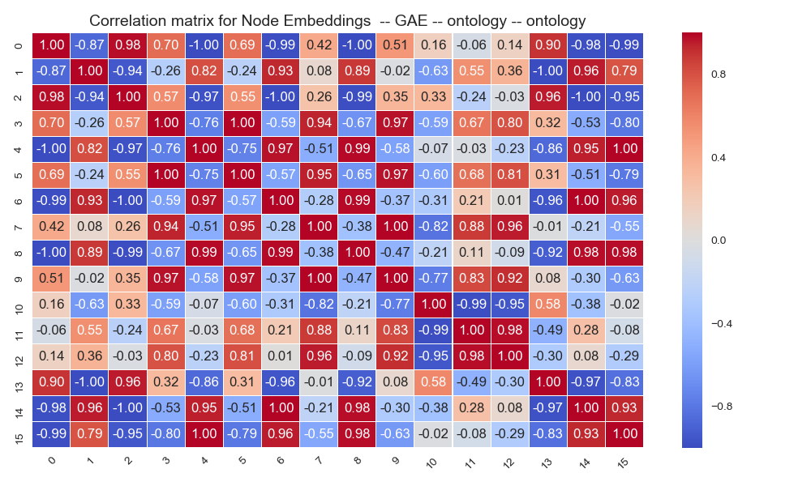
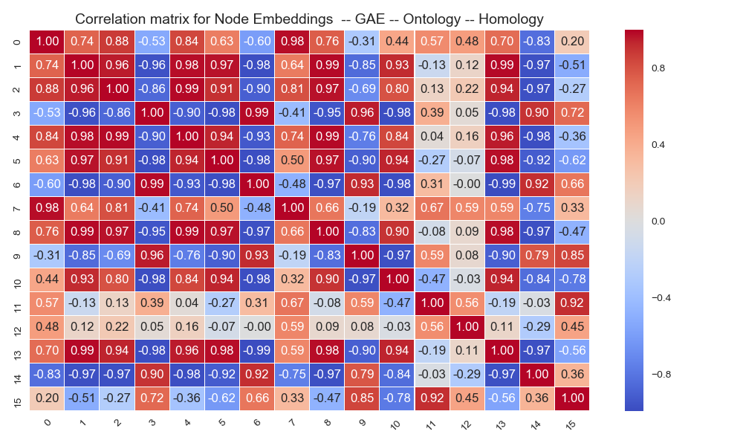
Correlation matrix for feature embedding
EXTRAS

Slide 45
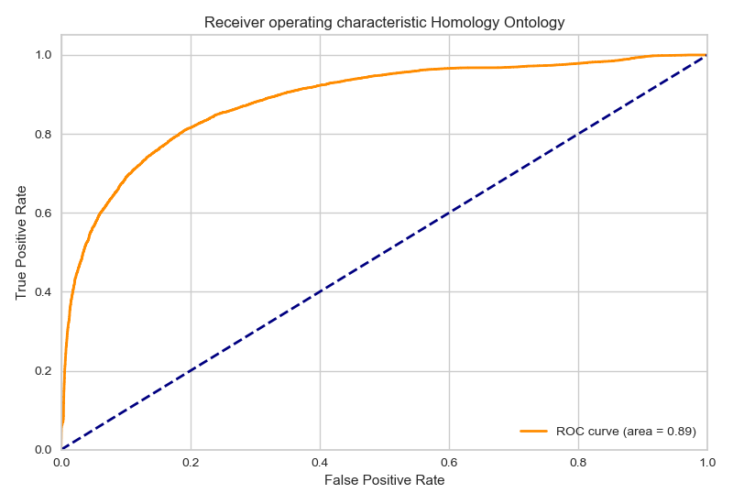
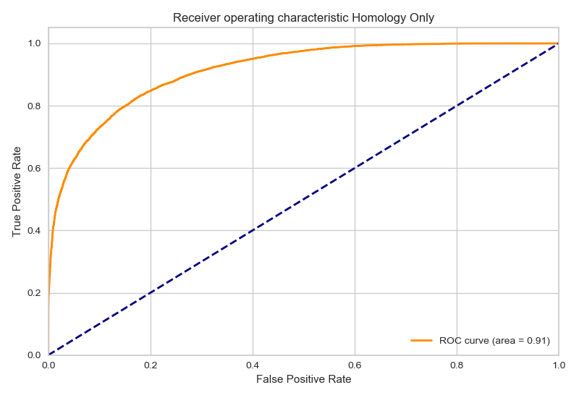
Receiver Operating Characteristics Graphs
EXTRAS

Slide 46
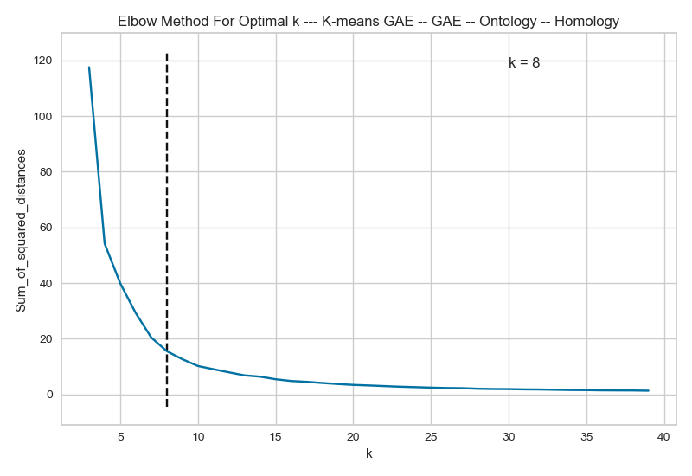
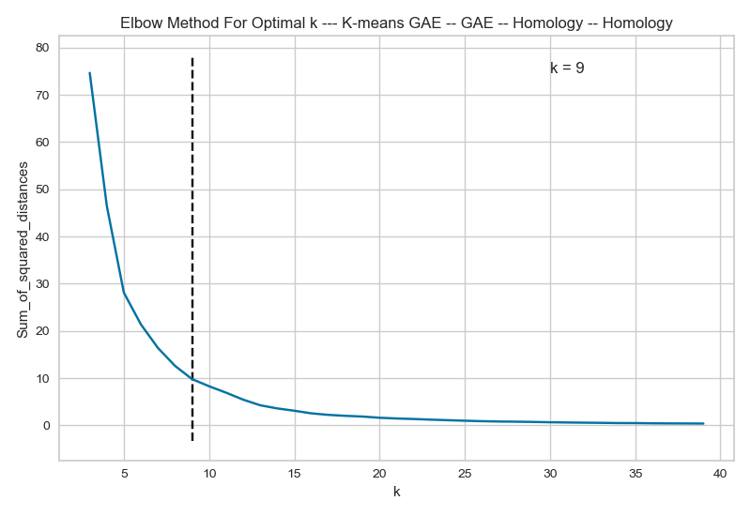
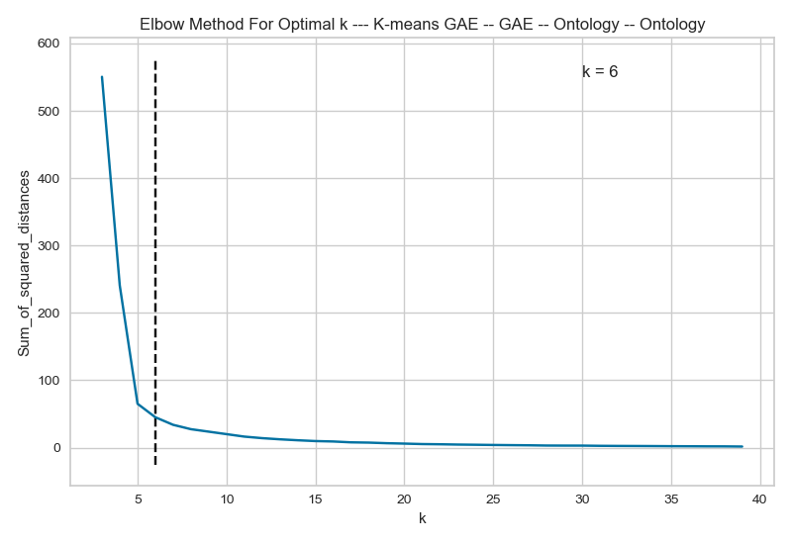
Elbow Method For Optimal K
EXTRAS

Slide 47
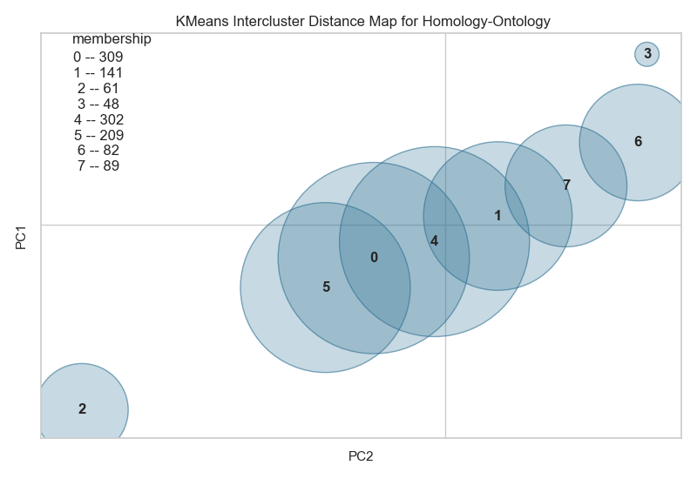
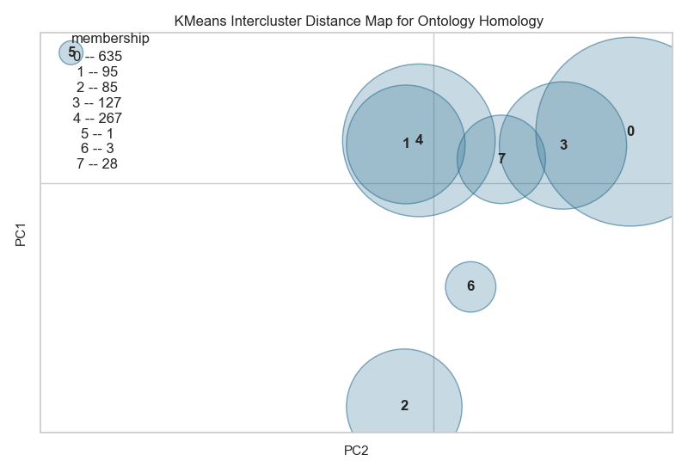
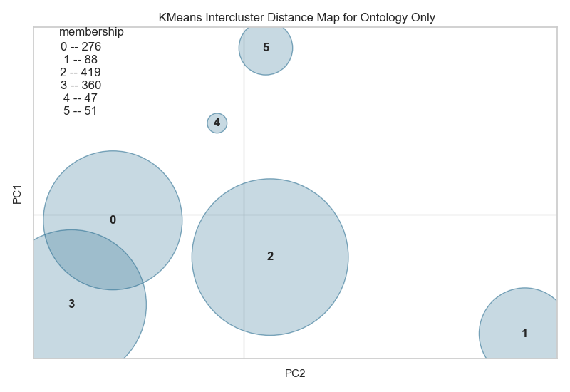
Intercluster Distance maps
EXTRAS

Slide 48
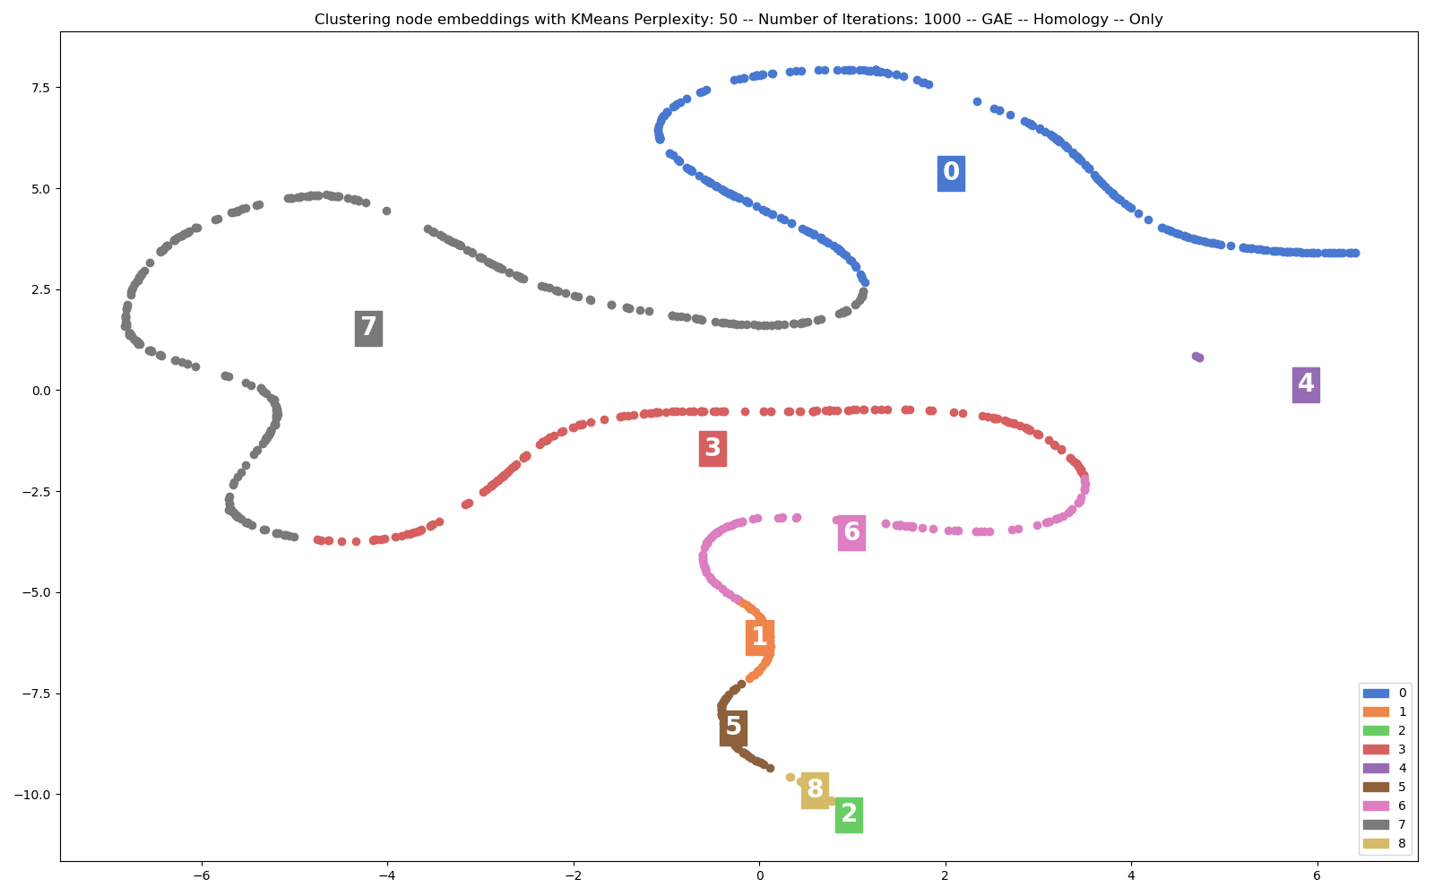
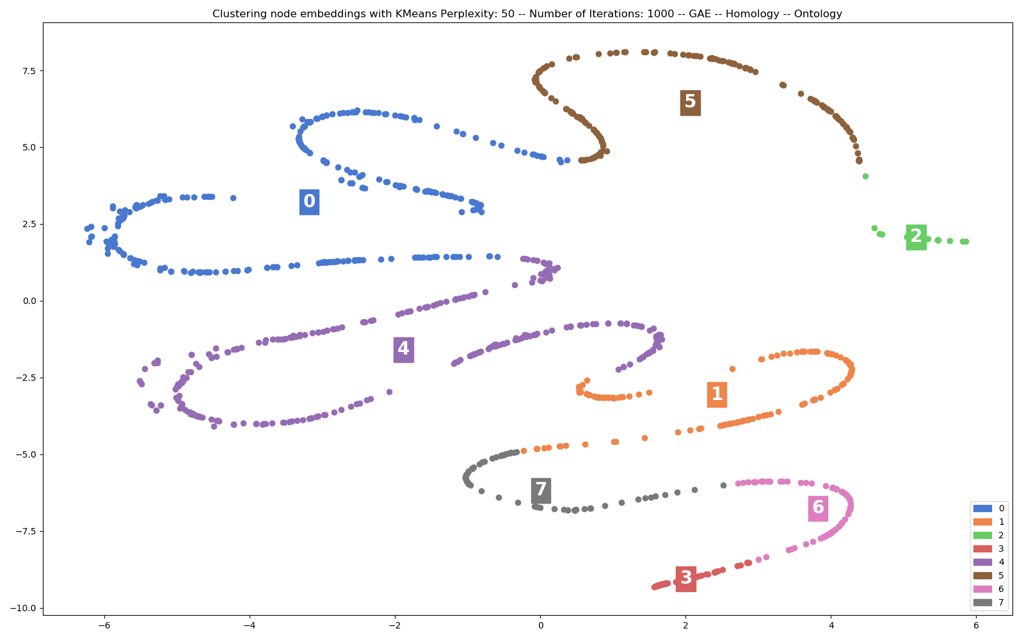
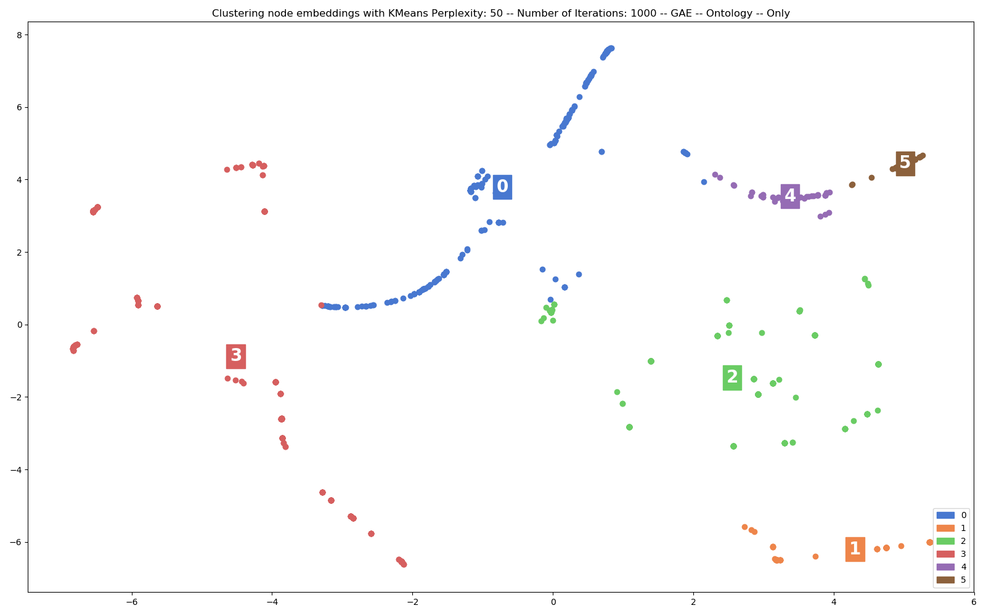
EXPERIMENTS AND RESULTS
1

Slide 49
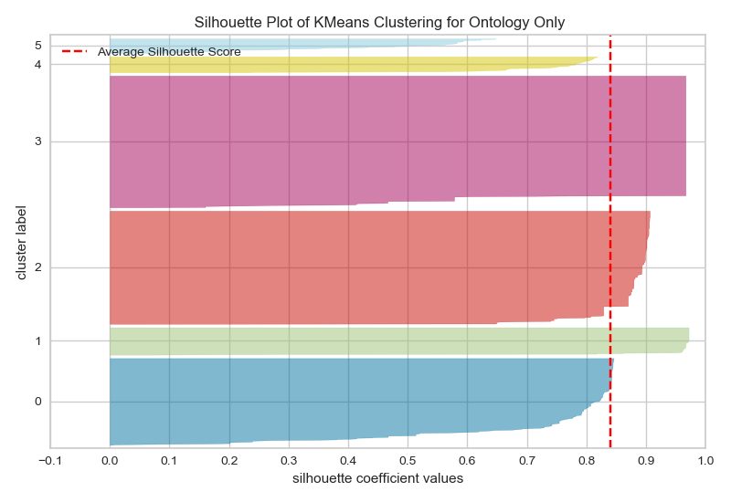
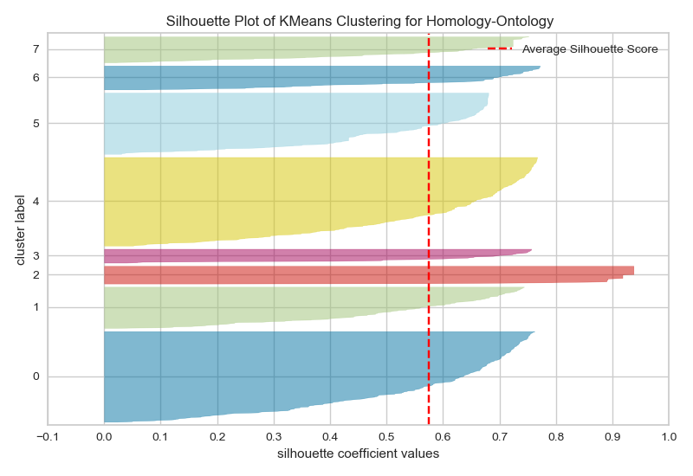
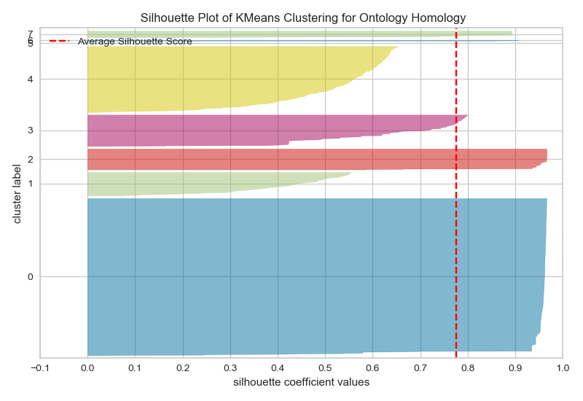
EXTRAS
Silhouette plots

Slide 50

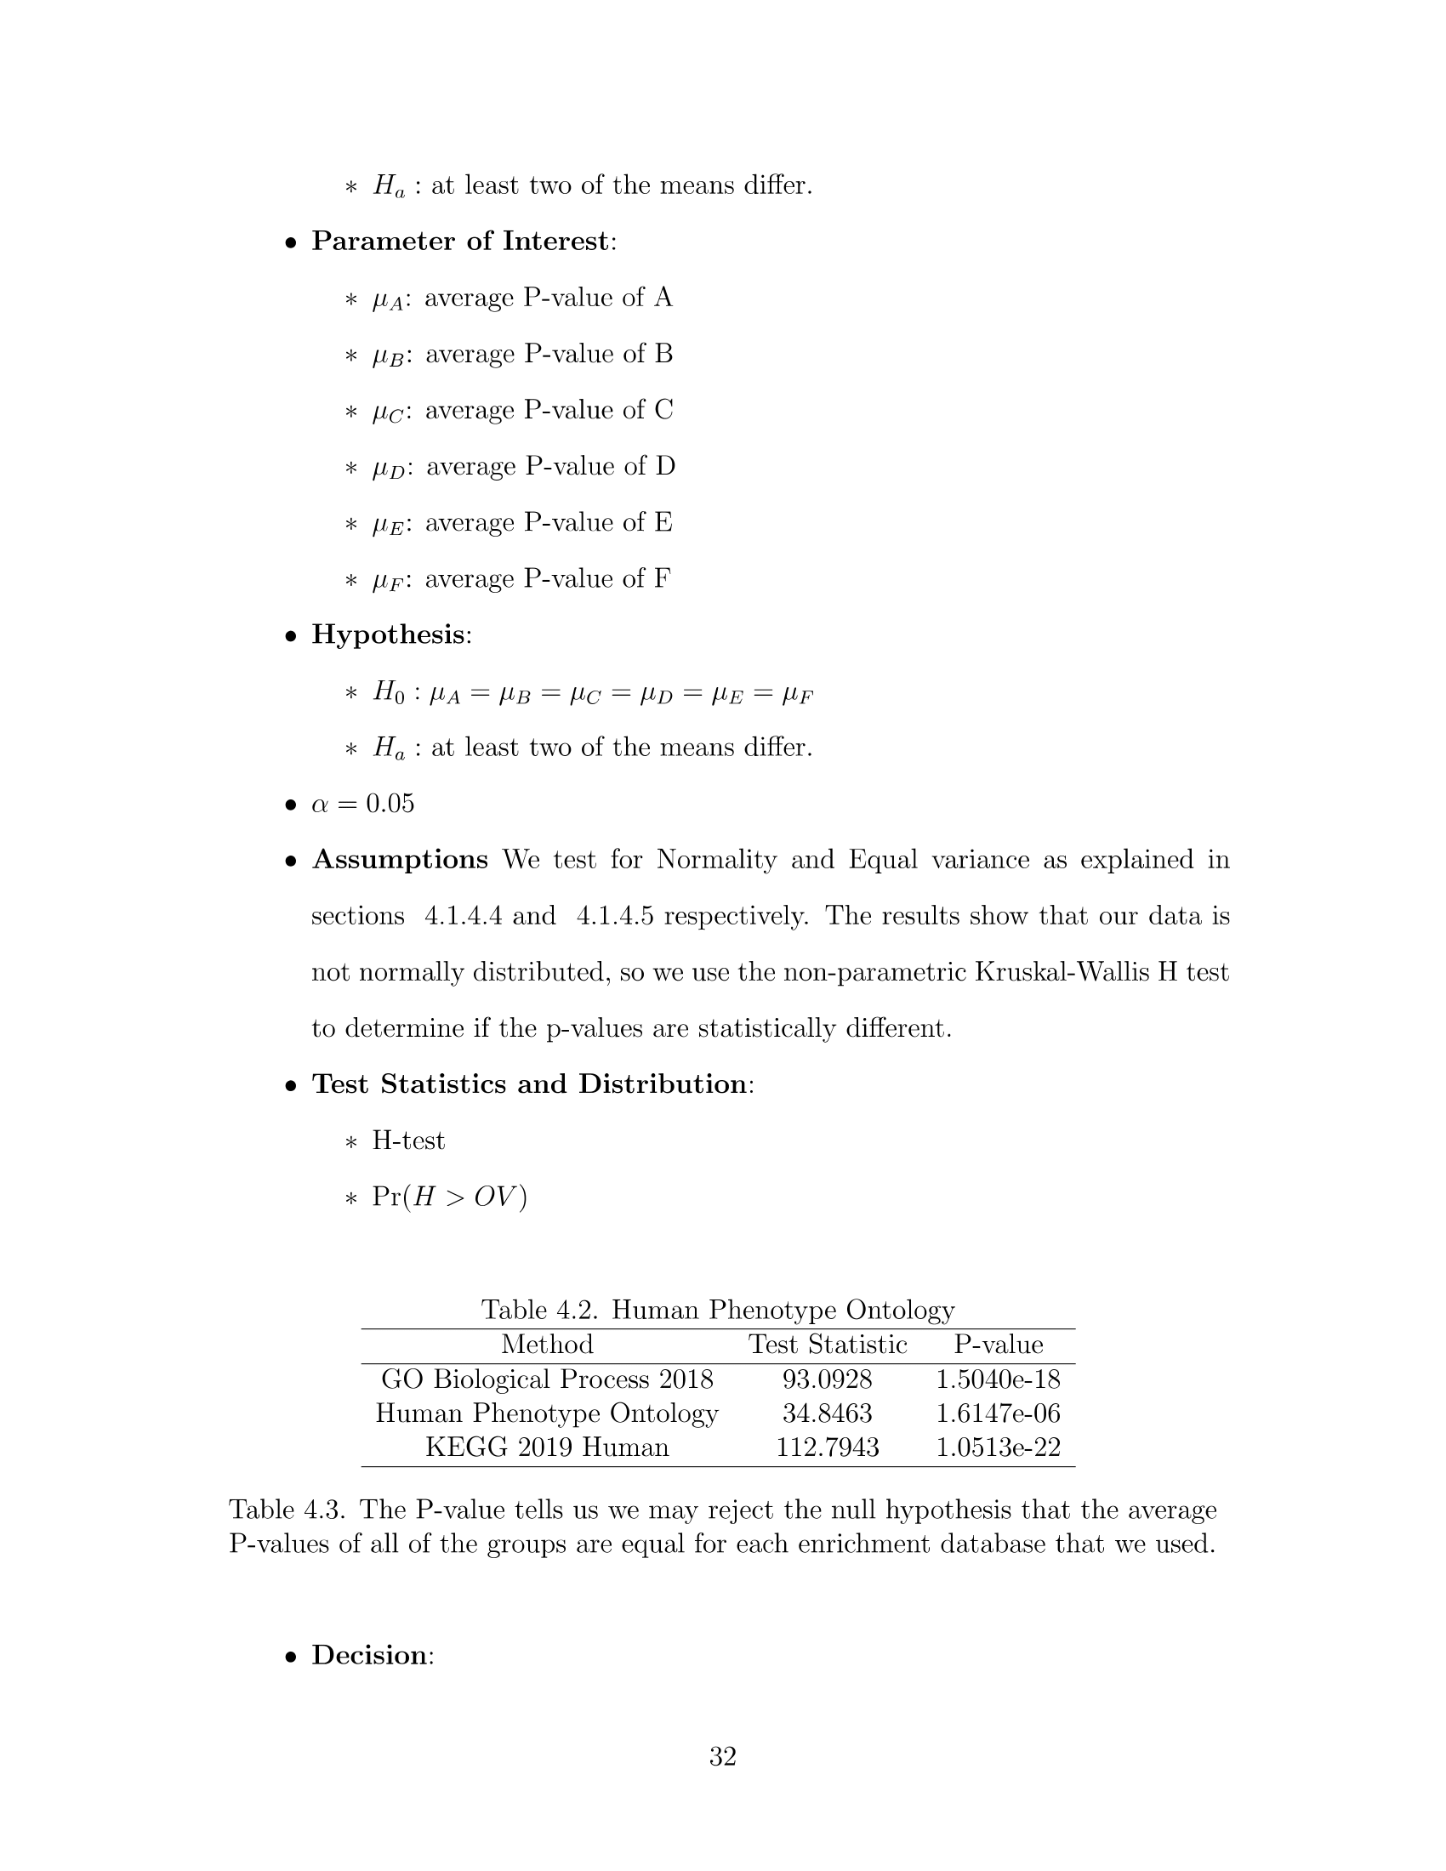
EXTRAS
ANOVA

Slide 51
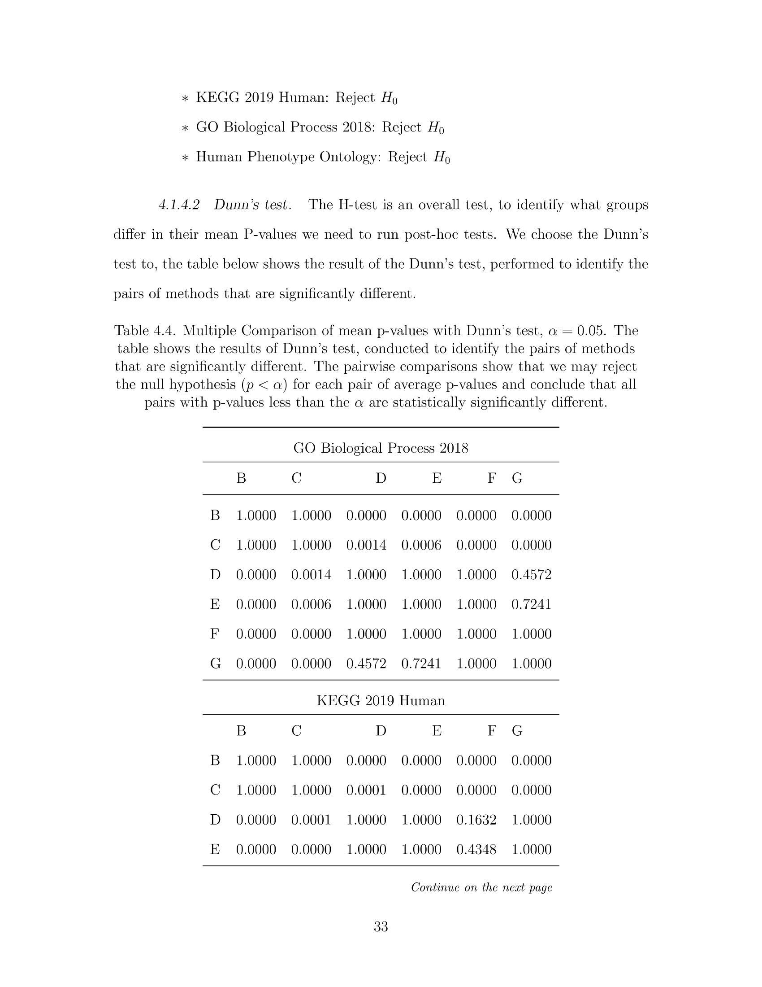
EXTRAS
ANOVA

Slide 52
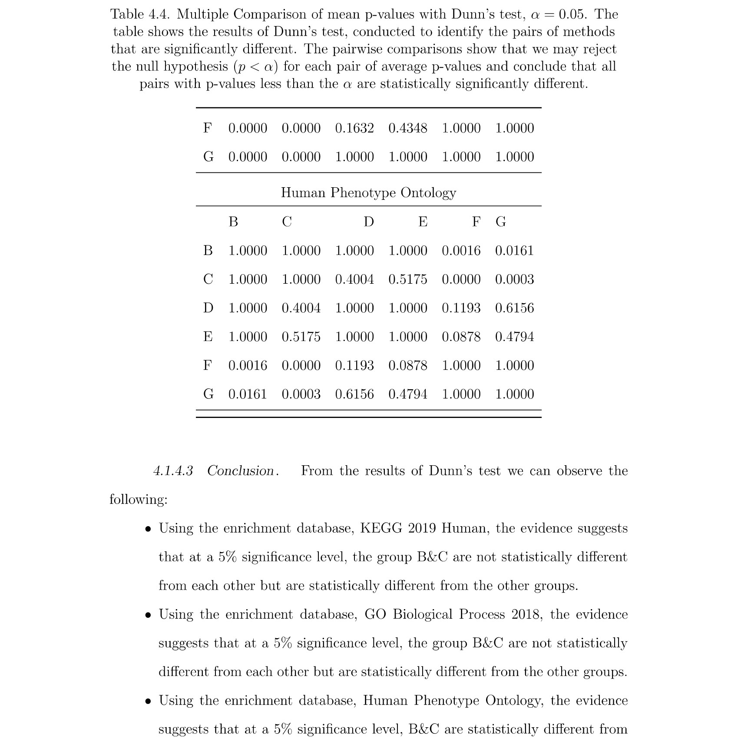
EXTRAS
ANOVA

Slide 53
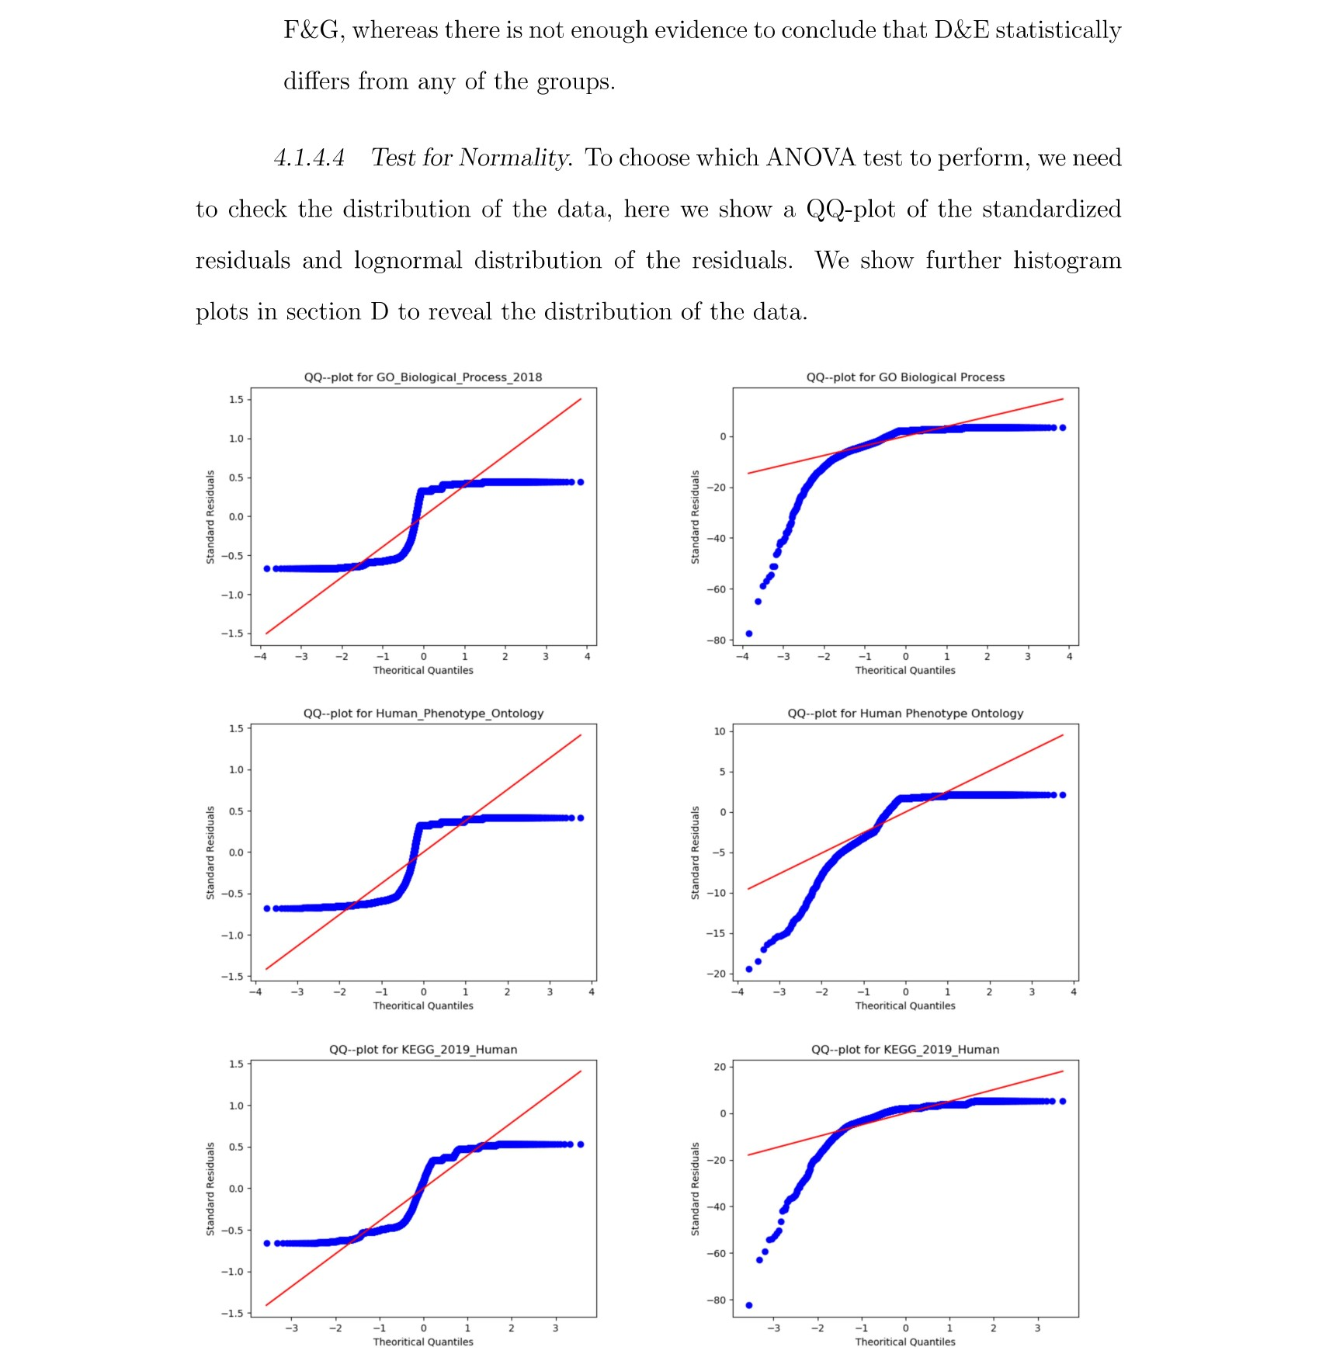
EXTRAS
ANOVA

Slide 54
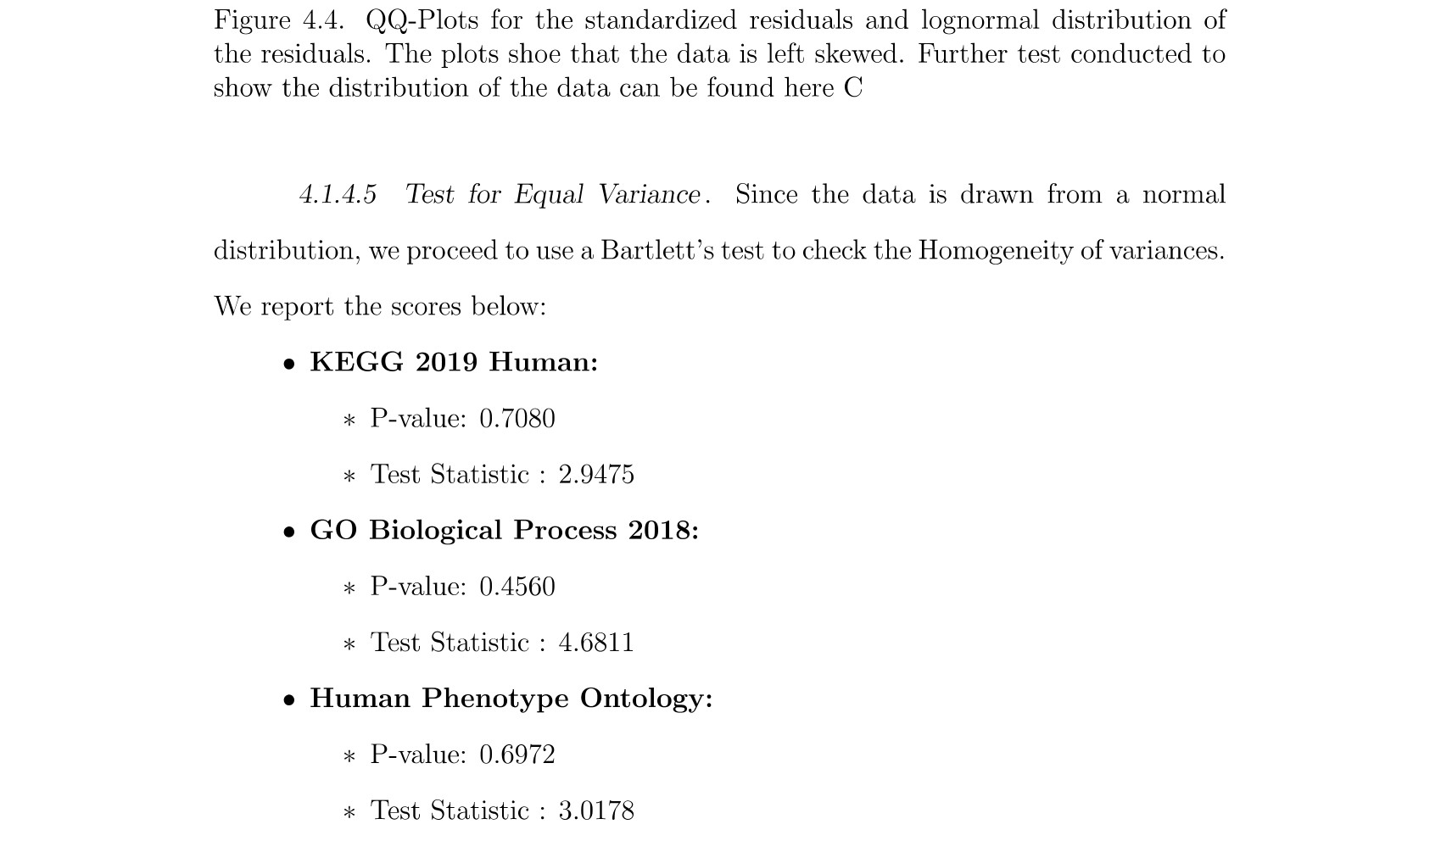
EXTRAS
ANOVA

Slide 55
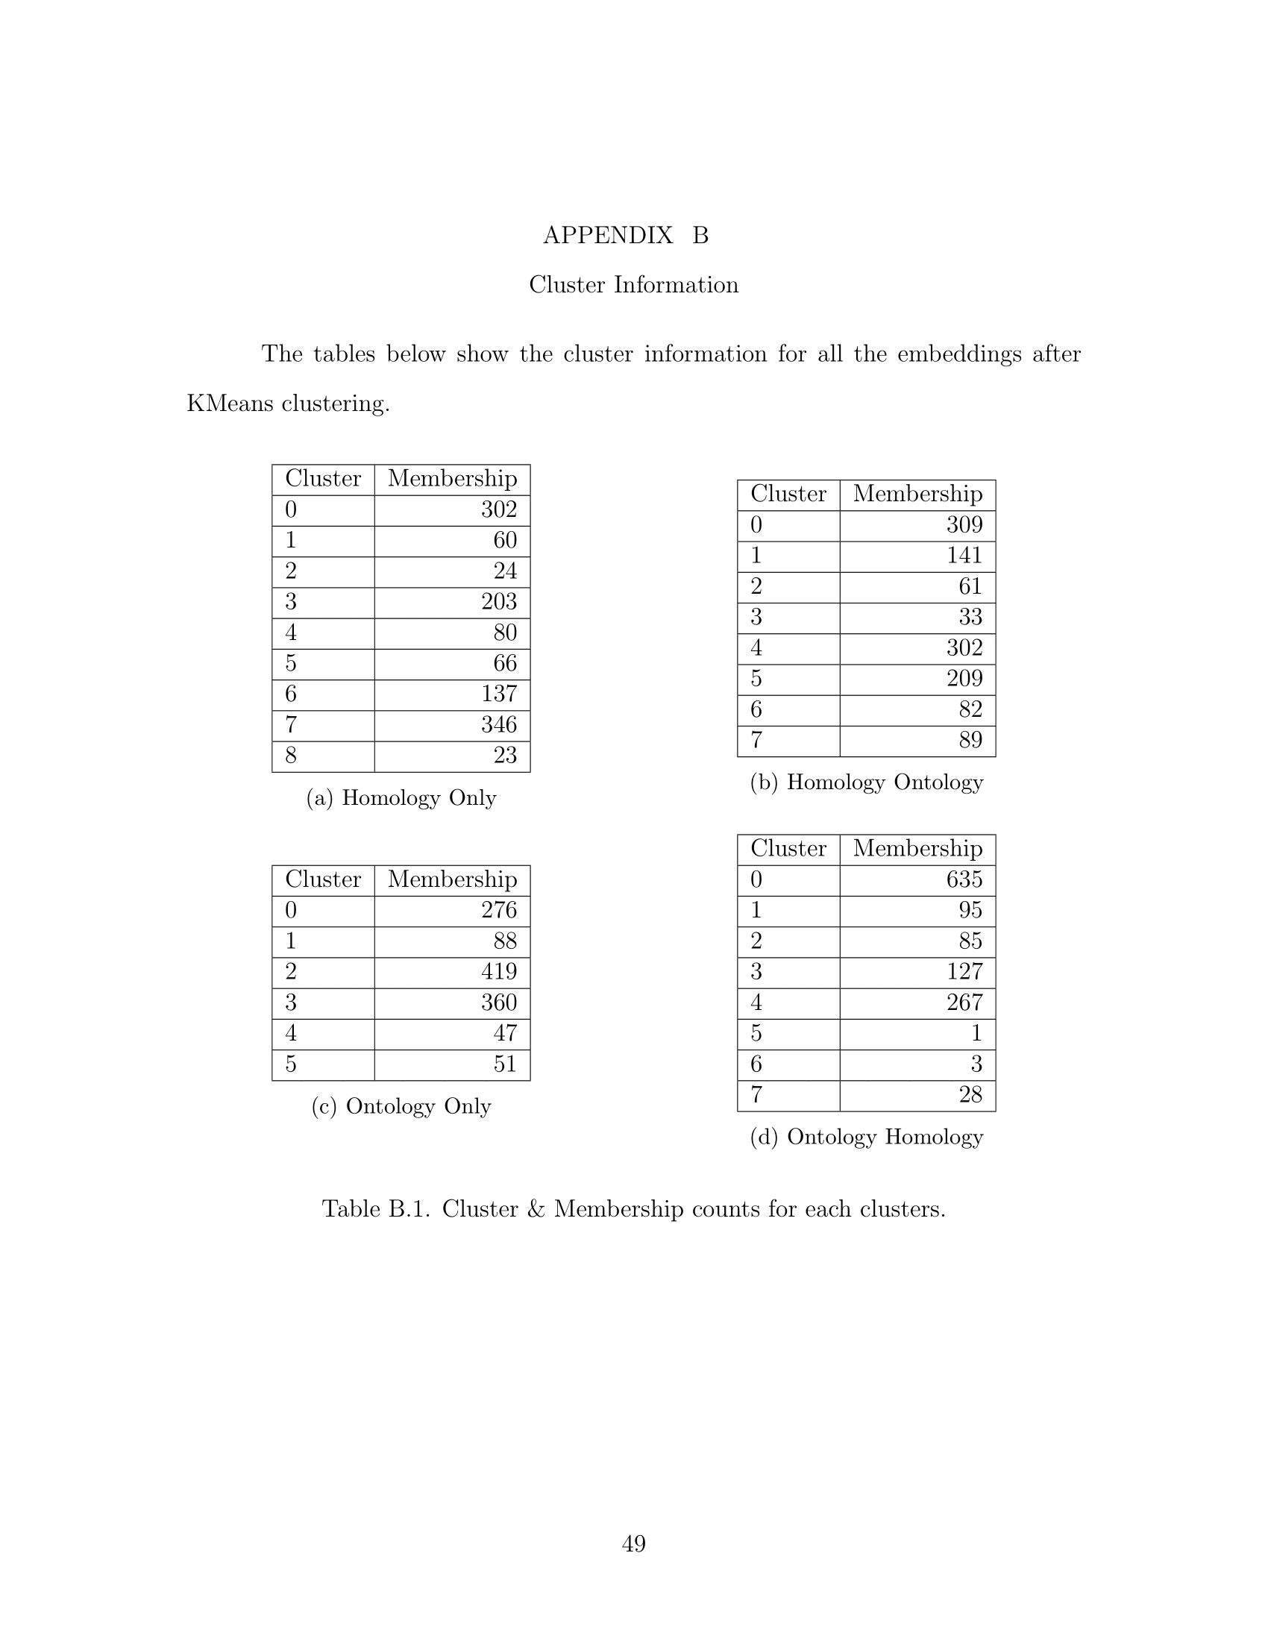
EXTRAS

Slide 56
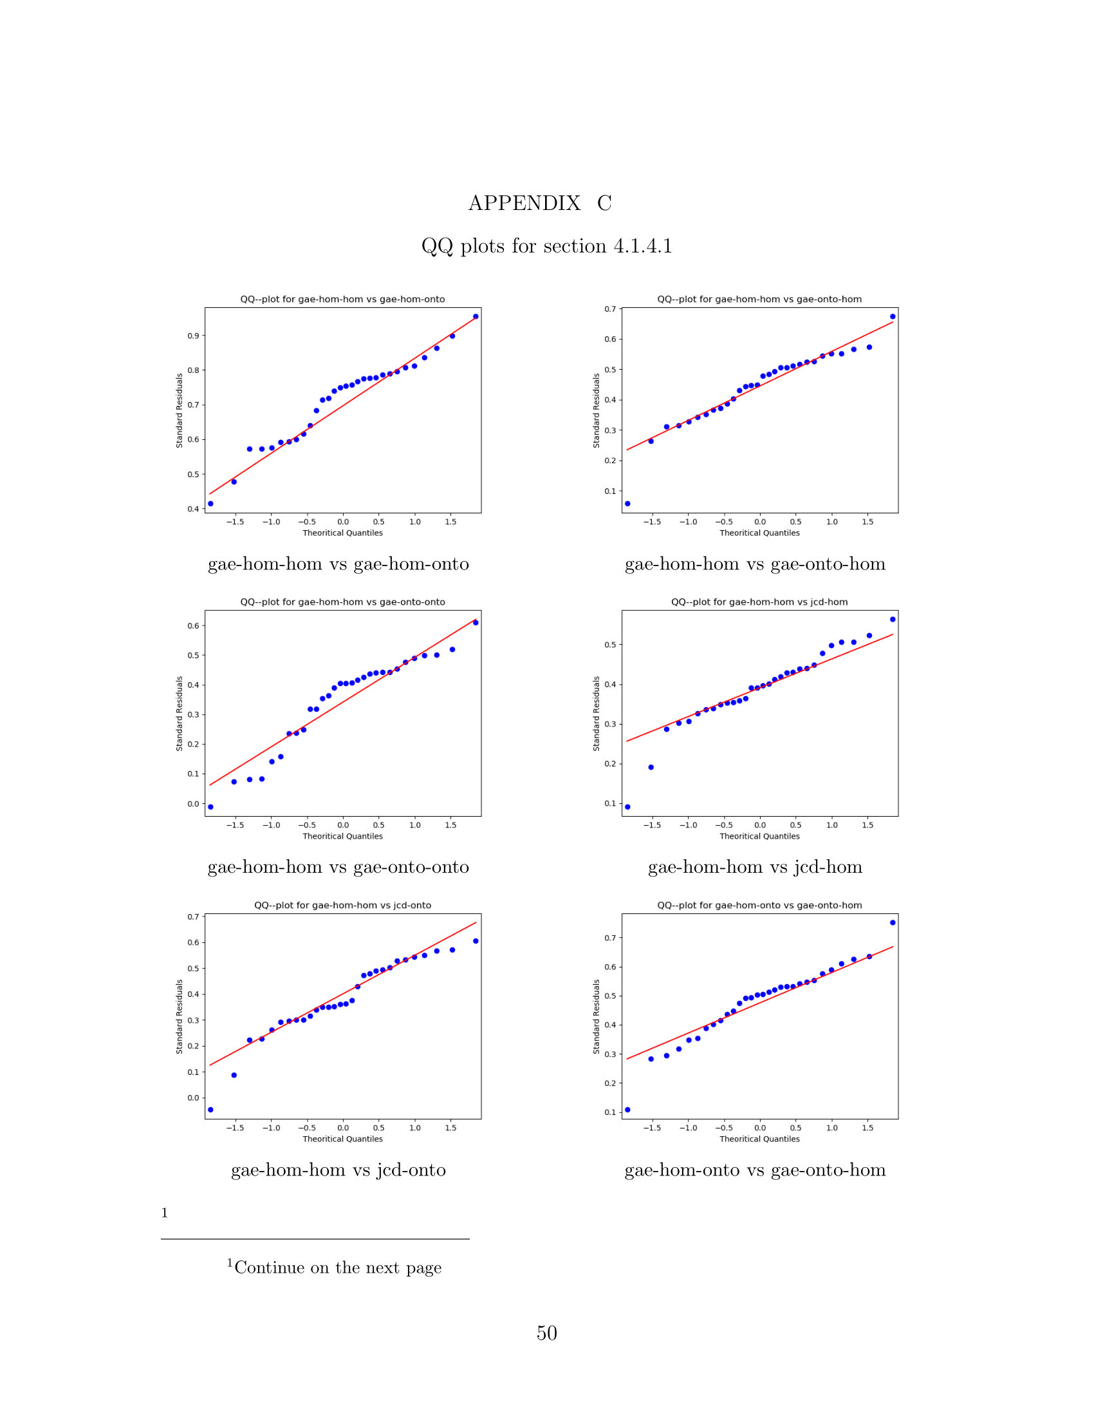
EXTRAS

Slide 57
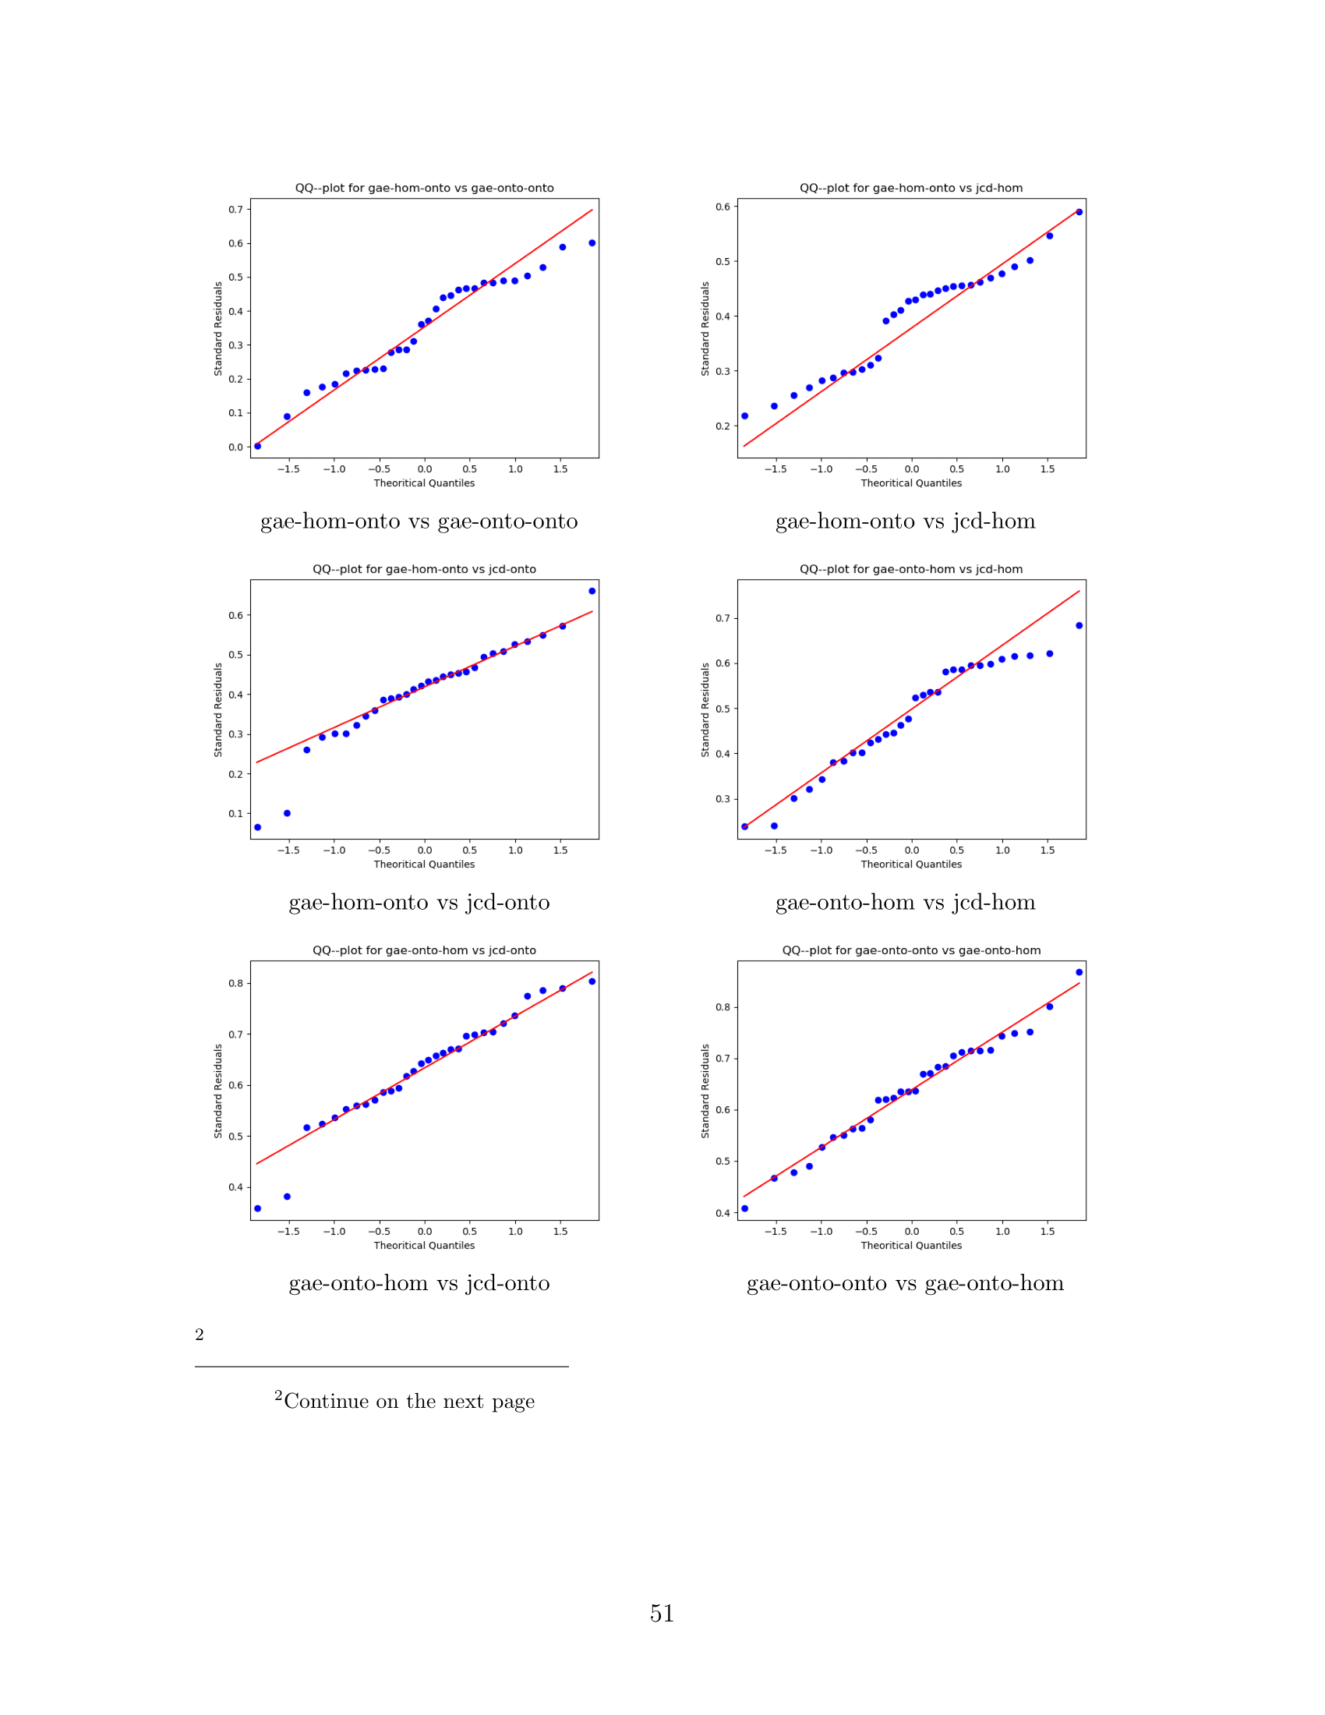
EXTRAS

Slide 58
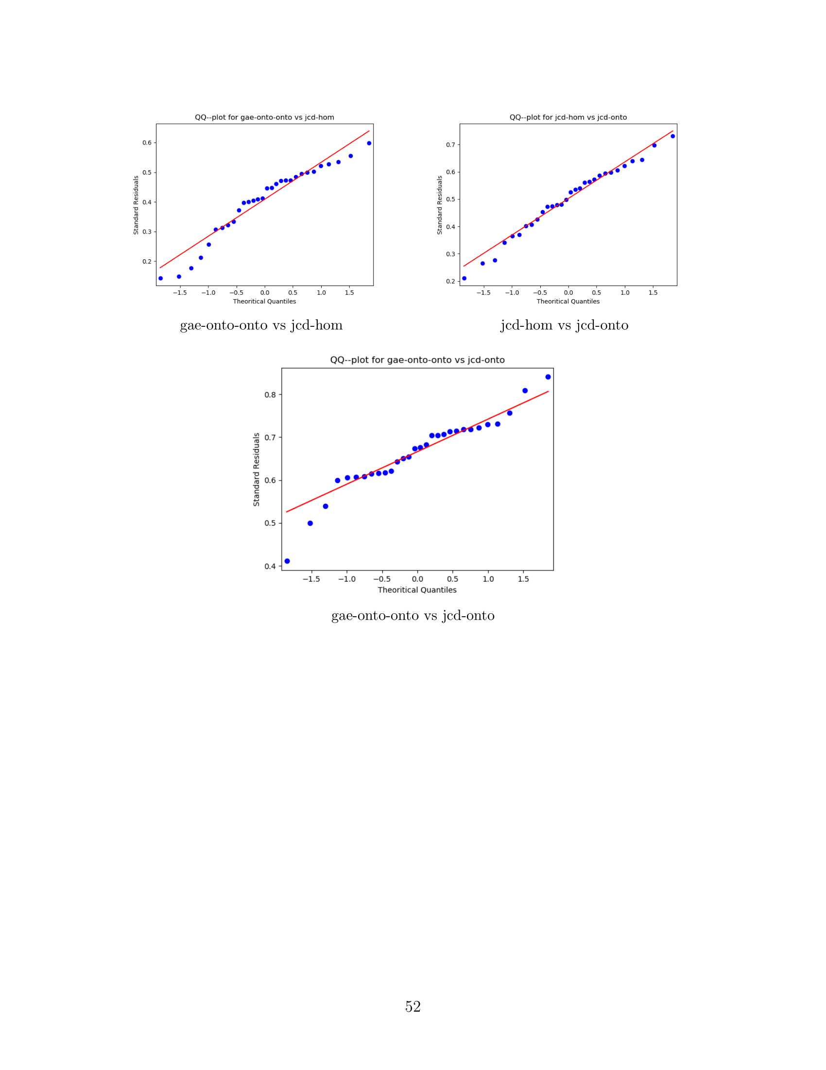
EXTRAS

Slide 59
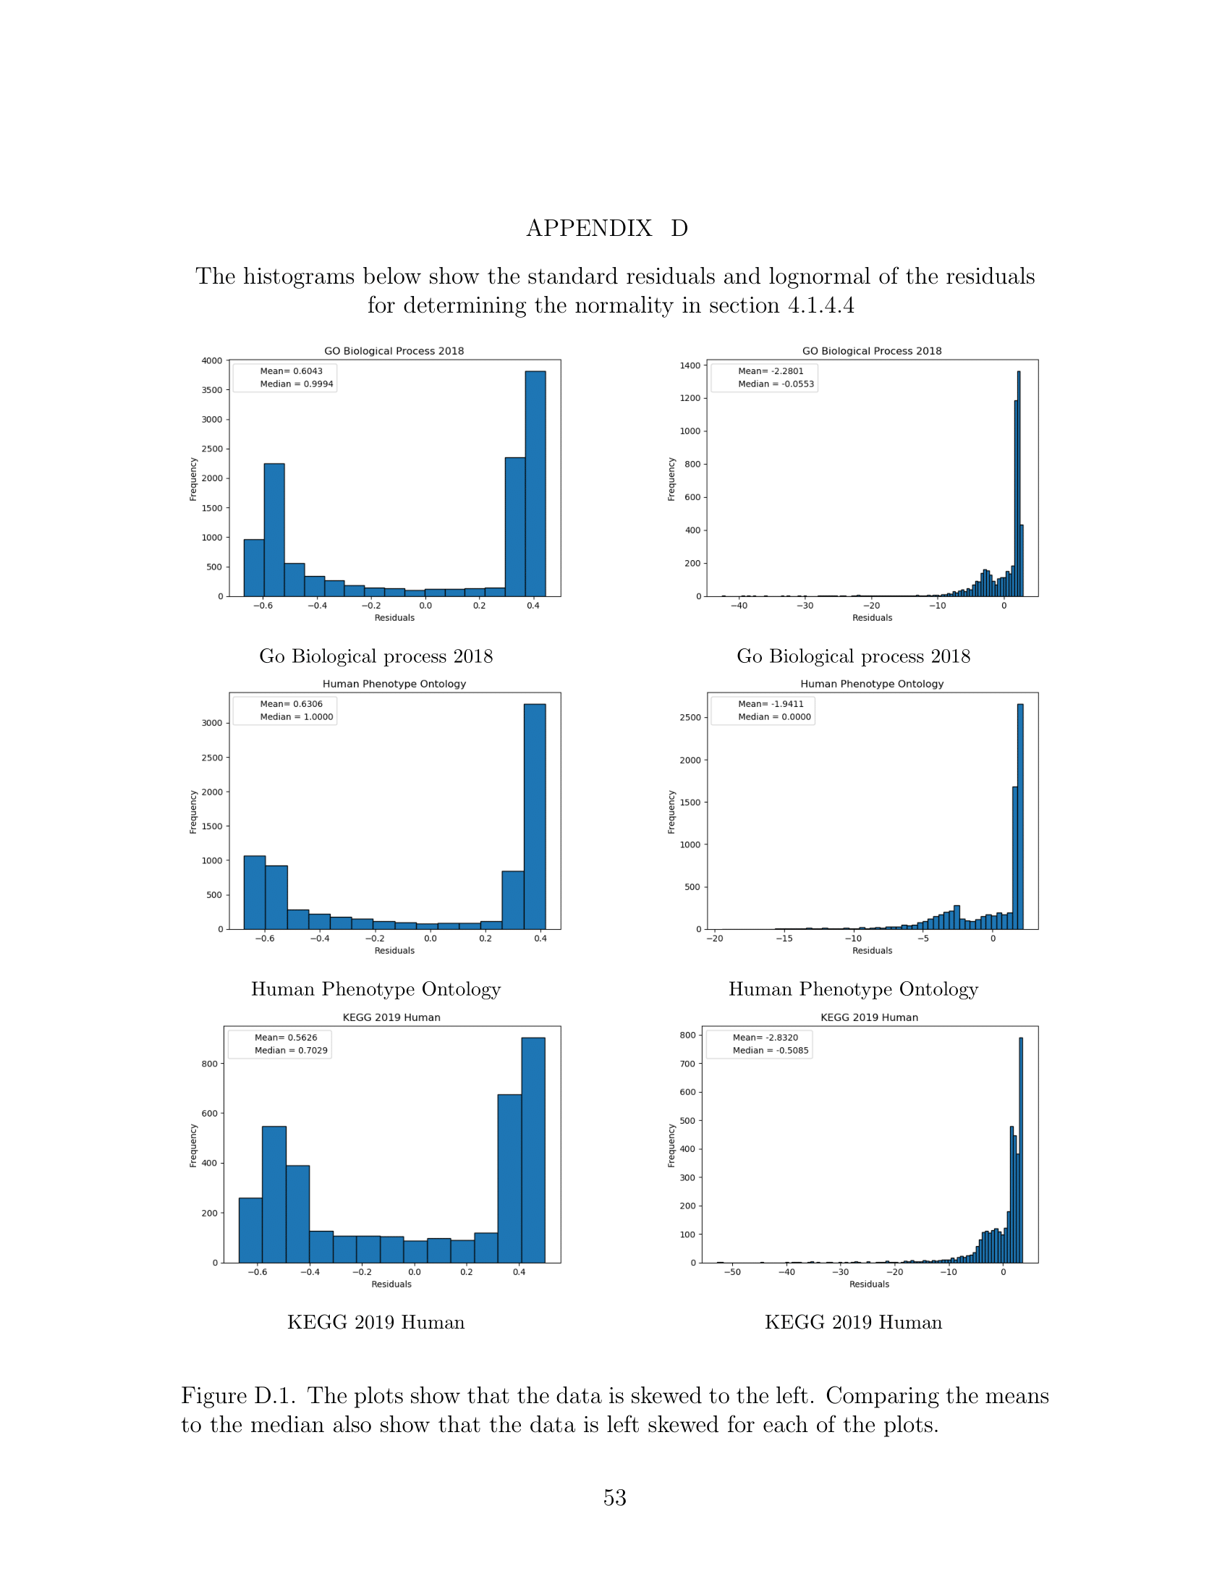
EXTRAS

Slide 60
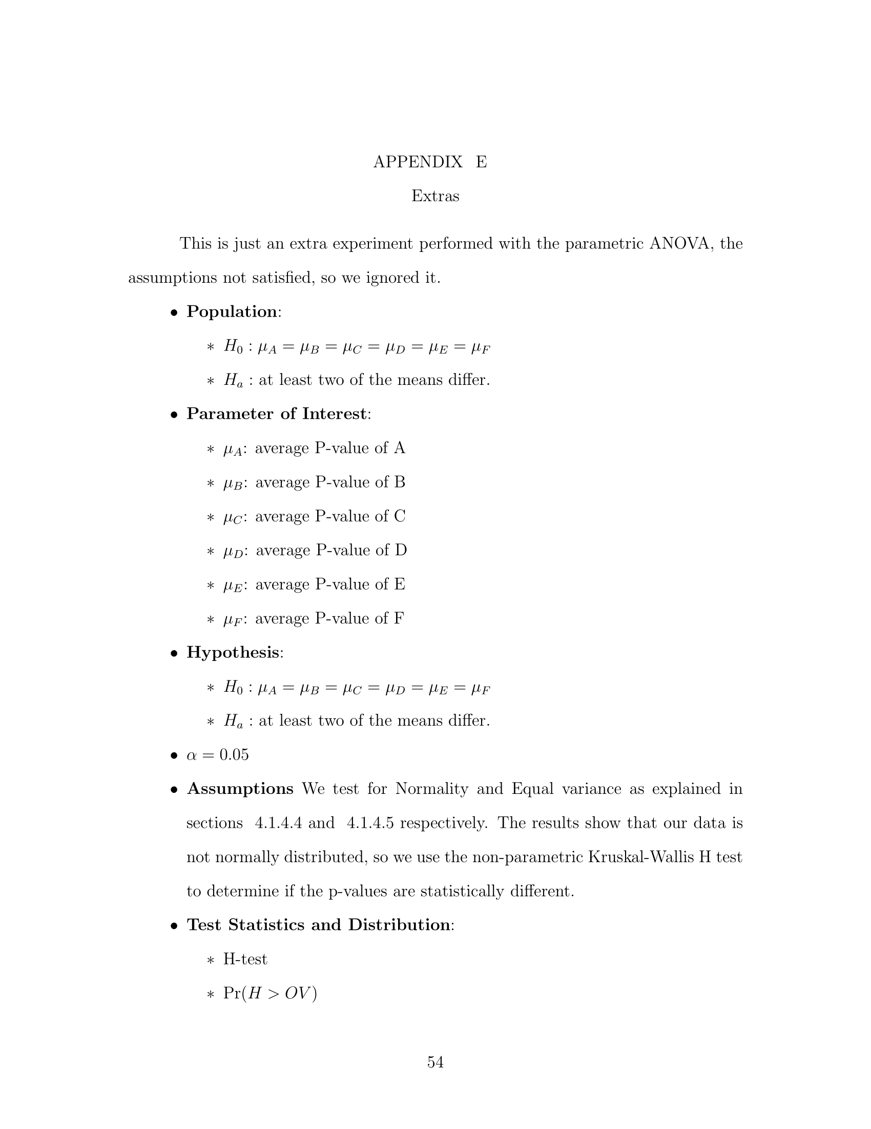
EXTRAS

Slide 61
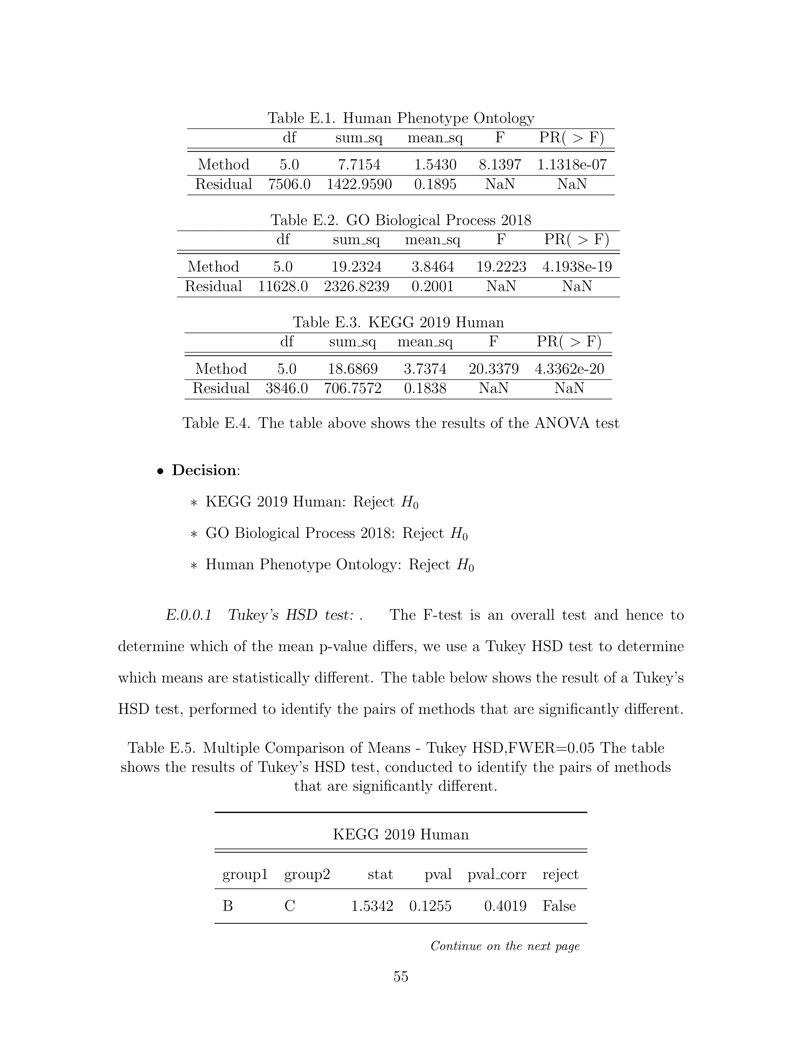
EXTRAS

Slide 62
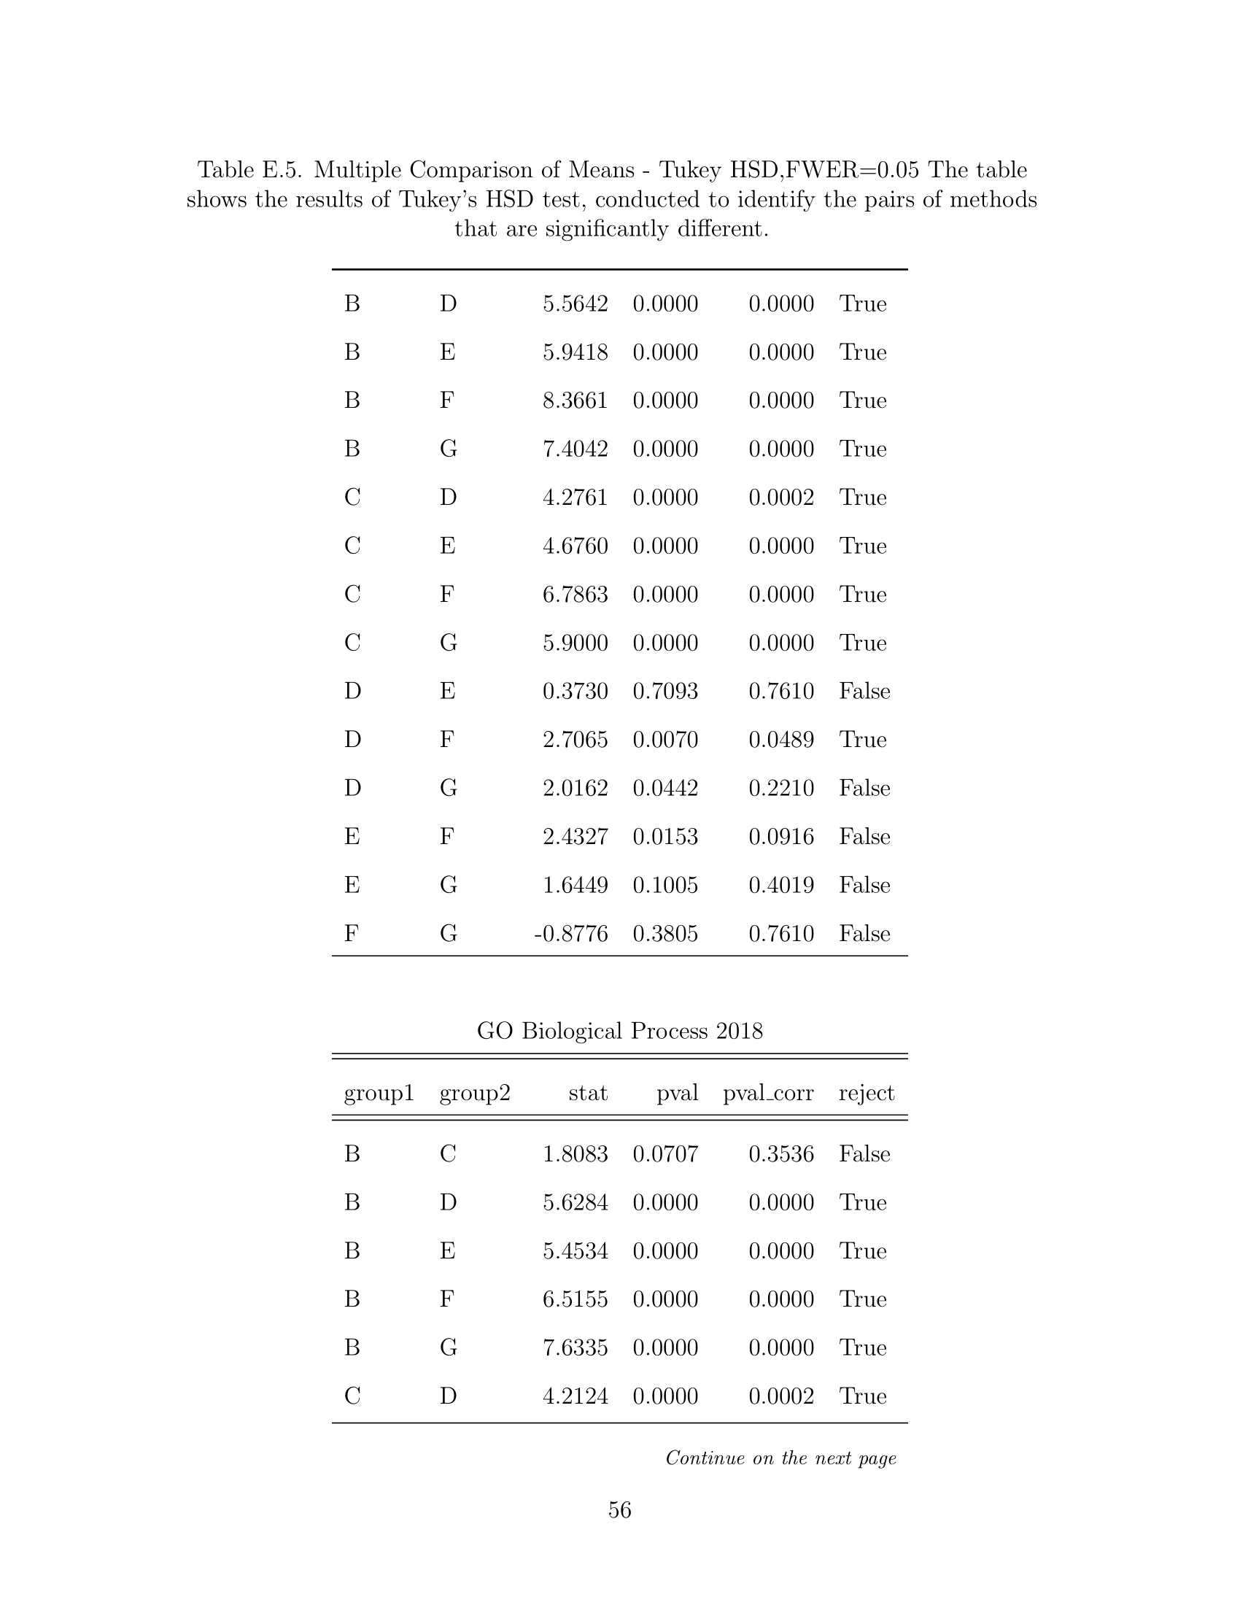
EXTRAS

Slide 63
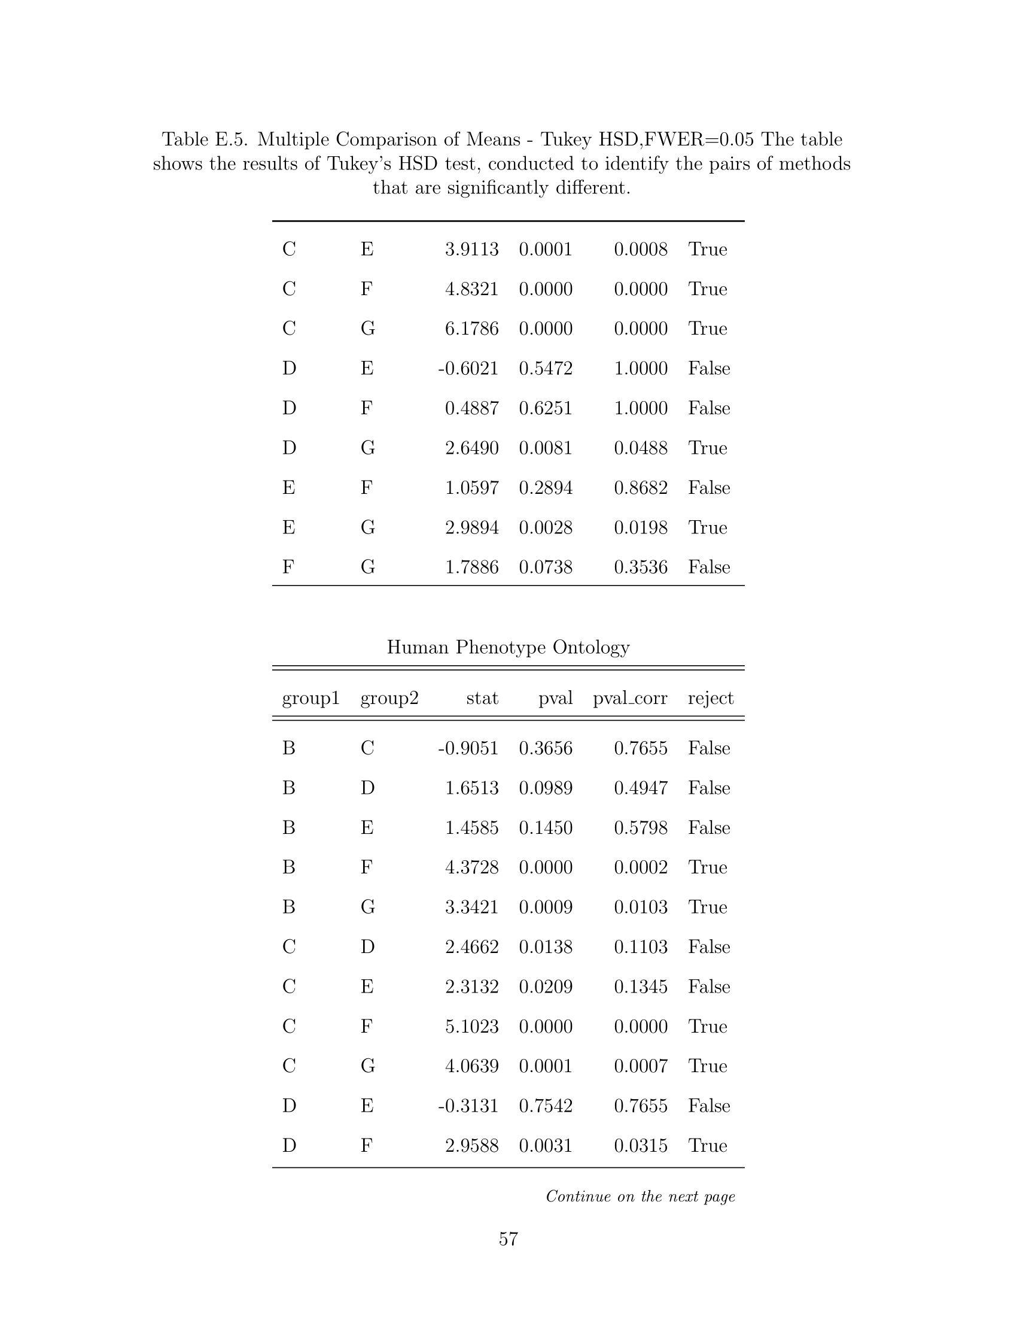
EXTRAS

Slide 64
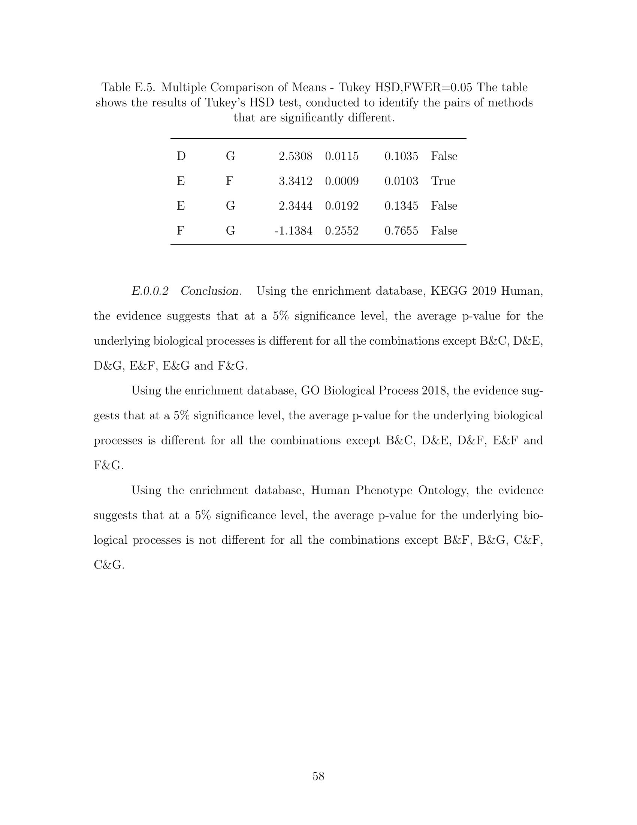
EXTRAS

Slide 65
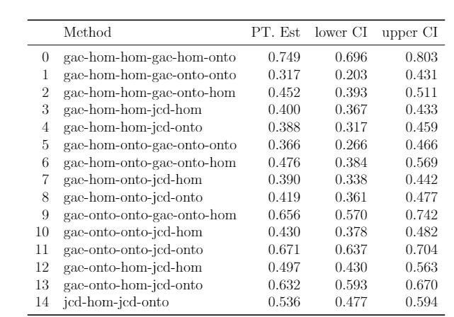
EXTRAS

